Slide 1
Lymphoma Learning Programme
for Nurses and
Allied Healthcare Professionals
September/2014

Slide 2
Module 5:
Clinical Trials

Slide 3
Module 5 Objectives
After completing this module, participants should be able to:
  Explain to patients the advantages and disadvantages of participating in a clinical trial
  Describe the key findings from major completed randomized controlled trials in patients with lymphoma and the therapeutic implications of these findings
  Describe the main ongoing clinical trials and their potential relevance for future management of patients with lymphoma

Slide 4
Module 5 Overview
Introduction to clinical trials
  What is a clinical trial?
  Types of clinical trials
  Risks and benefits of patient participation
  Safety monitoring in clinical trials
  The role of nurses in conducting clinical trials
Key completed clinical trials in patients with lymphoma
Key ongoing clinical trials in patients with lymphoma
European lymphoma study groups

Slide 5
Module 5A:
Introduction to Clinical Trials

Slide 6
M5-A
Introduction to Clinical Trials
Clinical trials
  Research studies that evaluate the safety and efficacy of drugs that have not yet been approved for marketing or new uses for already approved drugs in humans
  Prior to the first administration of an investigational product (IP) in humans, the product undergoes extensive laboratory and animal testing to learn about its safety and potential efficacy

Slide 7
M5-A
Introduction to Clinical Trials
4 Phases of clinical trials:
  Phase 1
    To determine the safety of the IP, including the maximum tolerated dose (MTD)
    Usually include a small number of patients with advanced / relapsed / refractory disease
    Increased risk of side effects
  Phase 2
    Evaluate the efficacy and safety of one or more doses of the IP on a larger number of patients compared to phase I
    Typically all patients receive the investigational drug (i.e. there is no control group)

Slide 8
M5-A
Introduction to Clinical Trials
4 Phases of clinical trials (cont’d):
  Phase 3
    The efficacy and safety of the IP is compared with a standard treatment in a randomized controlled trial
    Conducted on a large number of patients
    Pivotal Phase 3 trials form the basis of marketing approval for new drugs
  Phase 4
    Conducted after the drug is approved by the relevant regulatory agency (e.g. EMA in the European Union) and becomes part of standard therapy.
    Continued evaluation of safety and effectiveness

Slide 9
M5-A
Introduction to Clinical Trials
Randomization Scheme

Slide 10
M5-A
Introduction to Clinical Trials
Types of Clinical Trials
  Treatment trials
  Screening trials
  Prevention trials
  Diagnostic trials
  Health economic evaluations
  Quality-of-life, supportive or palliative care trials

Slide 11
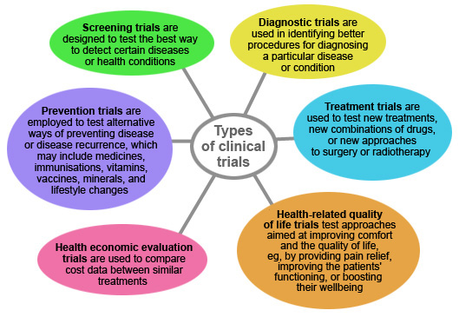
M5-A
Introduction to Clinical Trials
Types of Clinical Trials
Source: http://www.wellards.co.uk/

Slide 12

M5-A
Introduction to Clinical Trials
Risks and benefits of patient participation
Benefits:
Receiving new treatments that are not yet on the market
The knowledge gained from the trial can help further medical research and cancer care for the patient and other cancer patients
Risks:
All cancer drugs have side effects; some may be severe or fatal
There may be unknown / unforeseen risks
The IP may prove less effective than standard therapies or offer little or no benefit
Must be explained in the information and consent form
The key is a positive benefit : risk ratio!

Slide 13
M5-A
Introduction to Clinical Trials
Safety Monitoring in Clinical Trials
  The Principal Investigator (PI) has primary responsibility for safety monitoring of patients at his/her site
    Certain responsibilities may be delegated
  Study Sponsor has overall responsibility
  Study Safety Committee (if applicable)

Slide 14
M5-A
Introduction to Clinical Trials
The role of nurses in conducting clinical trials
  Patient recruitment
  Providing information about the study, assessments, risks involved, patient rights, etc.
  Study treatment administration, premedication, post-treatment observation
  Assessments and follow-up
  Data entry and quality
  Administrative roles

Slide 15
Module 5B:
Key Completed Lymphoma Trials

Slide 16
M4-B
Key Completed Lymphoma Trials
GELA LNH 98-5
R-CHOP-21 in elderly patients with DLBCL – Study design
R
A
N
D
O
M
I
Z
A
T
I
O
N
Rituximab 375 mg/m² IV Q3W, 8 cycles
CHOP Q3W, 8 cycles
Untreated
DLBCL
Age 60-80 yrs
CHOP Q3W, 8 cycles
399 patients
Notes:
Patients with severe neutropenia or febrile neutropenia received recombinant human
Source: Coiffier et al. 2002

Slide 17
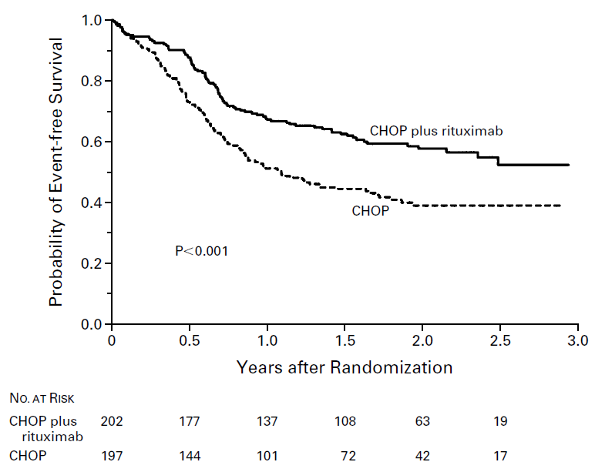
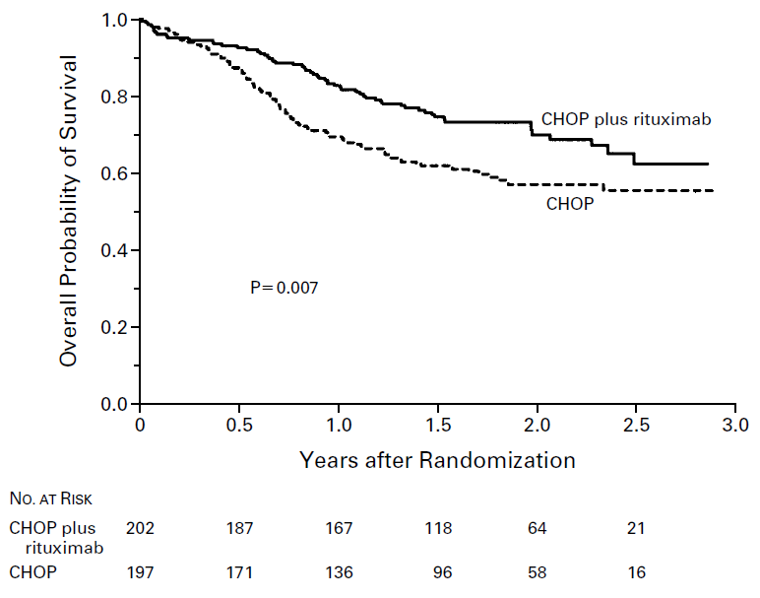
M4-B
Key Completed Lymphoma Trials
GELA LNH 98-5
R-CHOP-21 in elderly patients with DLBCL – 3-year results
Event-free Survival
Overall Survival
Source: Coiffier et al., 2002.

Slide 18
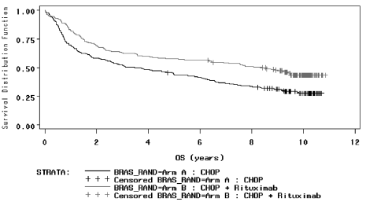
M4-B
Key Completed Lymphoma Trials
GELA LNH 98-5
R-CHOP-21 in elderly with DLBCL – Long-term survival
Median OS: 3.5 years in the CHOP arm and 8.4 years in the R-CHOP arm (P < 0.0001).
Source: Coiffier et al., 2010.

Slide 19
M4-B
Key Completed Lymphoma Trials
MiNT Study
R-CHOP-21 in younger patients with DLBCL – Study design
R
A
N
D
O
M
I
Z
A
T
I
O
N
Rituximab 375 mg/m² IV
Q3W, 6 cycles
CHOP-like Chemotherapy* Q3W, 6 cycles
Untreated
DLBCL
Age 18-60 yrs
823 patients
CHOP-like Chemotherapy*
Q3W, 6 cycles
* CHOP-21, CHOEP-21, MACOP-B or PMitCEBO
Source: Pfreundschuh et al. 2006

Slide 20
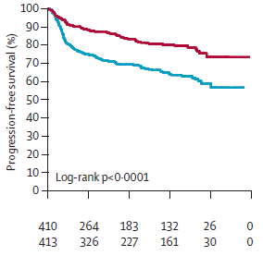
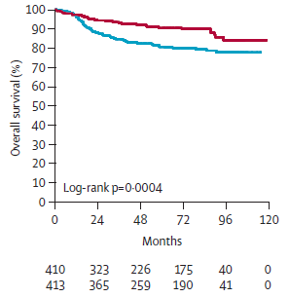
M4-B
Key Completed Lymphoma Trials
MiNT Study
R-CHOP-21 in younger patients with DLBCL – Study Results
Progression-free Survival
Overall Survival
Source: Pfreundschuh et al., 2011.

Slide 21
M4-B
Key Completed Lymphoma Trials
RICOVER-60
R-CHOP-14 in elderly patients with DLBCL – Study design
R
A
N
D
O
M
I
Z
A
T
I
O
N
Rituximab 375 mg/m² IV Q2W, 8 cycles
CHOP-14, 8 cycles
CHOP-14, 8 cycles
Untreated
Aggressive NHL
Age 61-80 yrs
Rituximab 375 mg/m² IV Q2W, 8 cycles
CHOP-14, 6 cycles
1,242 patients
CHOP-21, 6 cycles
Notes:
All patients received recombinant human G-CSF(filgrastim or lenograstim) starting on day 6 until WBC recovery;
Patients with initial bulky disease (diameter ≥7.5 cm) or extranodal involvement also received radiotherapy (36 Gy)
Source: Pfreundschuh et al. 2008

Slide 22
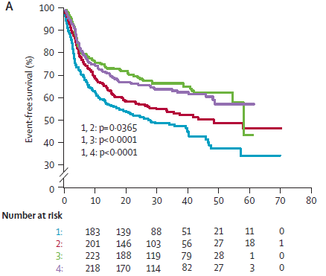
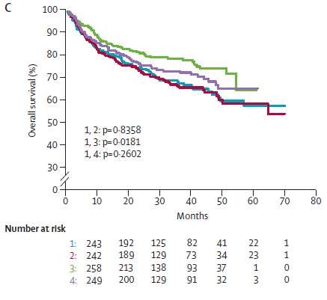
M4-B
Key Completed Lymphoma Trials
RICOVER-60
R-CHOP-14 in elderly patients with DLBCL – Study results
1 = 6 × CHOP-14; 2 = 8 × CHOP-14; 3 = 6 × R-CHOP-14; 4 = 8 × R-CHOP-14
Source: Pfreundschuh et al., 2008.

Slide 23
M4-B
Key Completed Lymphoma Trials
SAKK 35/98 Study
Standard vs. prolonged rituximab in FL - Study design
Induction
Randomization
Maintenance
CR
CRu
PR
SD
Rituximab IV 375 mg/m²
x 4 weekly Q2mo
Newly diagnosed or refractory/ relapsed FL
Rituximab IV 375 mg/m² x 4 weekly
151 patients
Observation
202 patients
Week 12
PD
off study
Source: Ghielmini et al. ASCO 2009. Abstract 8512.

Slide 24
M4-B
Key Completed Lymphoma Trials
SAKK 35/98 Study
Standard vs. prolonged rituximab in FL - Study results
Source: Ghielmini et al. ASCO 2009. Abstract 8512.

Slide 25
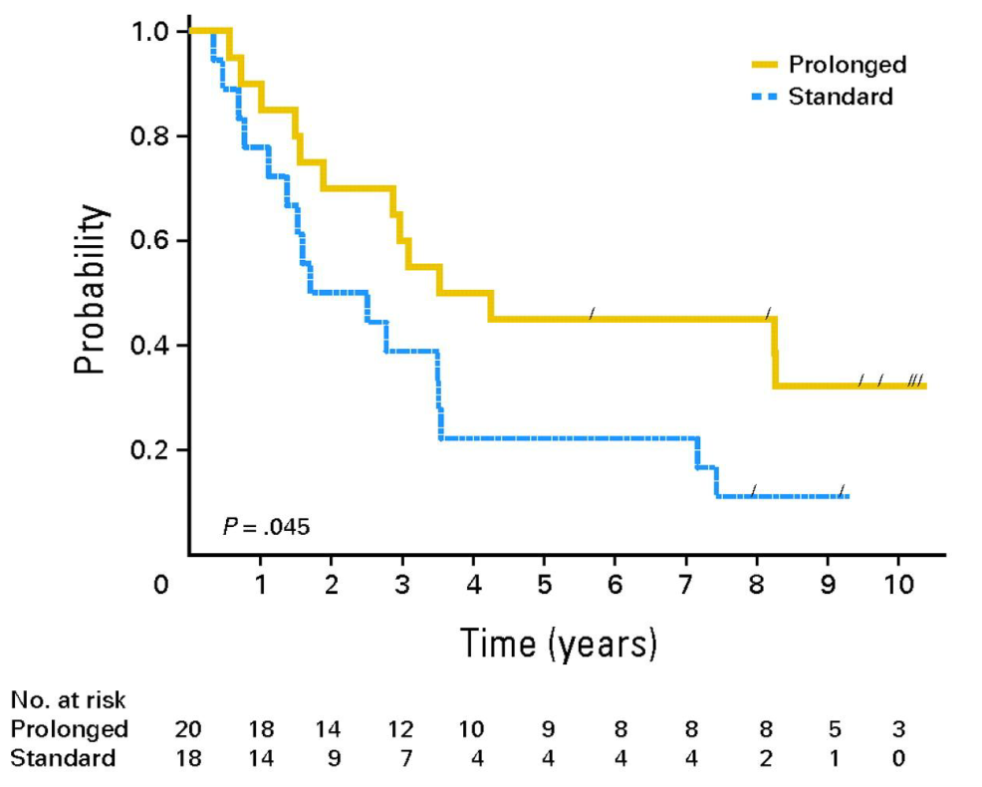
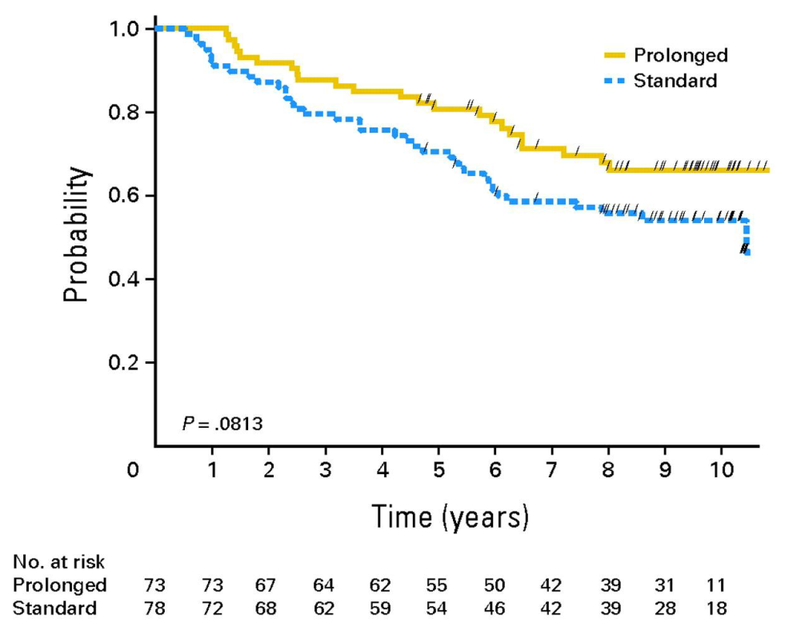
M4-B
Key Completed Lymphoma Trials
SAKK 35/98 Study
Standard vs. prolonged rituximab in FL - Study results
EFS in Responders to Induction Therapy
Overall Survival
Source: Martinelli et al. 2010.

Slide 26
M4-B
Key Completed Lymphoma Trials
PRIMA Study: Rituximab maintenance vs observation after first-line R-chemo - Study design
Induction
8 x Rituximab
Maintenance
12 x Rituximab
(Q2mo for 24 mo)
Untreated
follicular NHL
High tumour
burden
CR
CRu
PR
Chemotherapy
(8 x CVP or 6 x CHOP
or 6 x FCM)
1,018 patients
Observation
1,217 patients
PD
SD
off study
All initial pretreatment characteristics were well balanced between arms and response status at the time of randomization was CR = 39%; CRu = 32% and PR = 28% (others 1%)
Source: Salles et al., 2011.

Slide 27
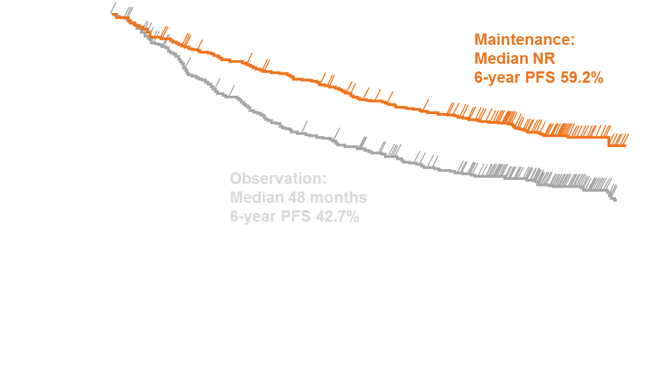
M4-B
Key Completed Lymphoma Trials
Rituximab maintenance vs observation after first-line R-chemo (PRIMA): Progression-free survival (PFS)
Source: Salles et al., 2011.

Slide 28
Module 5C:
Key Ongoing Lymphoma Trials

Slide 29
M4-B
Key Ongoing Lymphoma Trials
Rituximab maintenance after first-line R-bendamustine (MAINTAIN): Study design
Induction
Randomization
Maintenance
Rituximab (Q2mo for 4 yrs)
FL
Rituximab (Q2mo for 2 yrs)
Untreated
NHL
High tumour
burden
Rituximab
CR
PR
Bendamustine
MZL
MCL
SLL
WM
Rituximab (Q2mo for 2 yrs)
1,134 patients
Observation
PD
SD
off study
Source: clinicaltrials.gov (NCT00877214)

Slide 30
M4-B
Key Ongoing Lymphoma Trials
Obinutuzumab+CHOP vs Rituximab+CHOP (GOYA): Study design
R
A
N
D
O
M
I
Z
A
T
I
O
N
Obinutuzumab 1,000 mg IV
Q3W, 8 cycles*
CHOP IV
Q3W, 6 or 8 cycles
Untreated
DLBCL
1,400 patients
Rituximab 375 mg/m² IV
Q3W, 8 cycles
CHOP IV
Q3W, 6 or 8 cycles
* Additional dose on Day 1 and Day 8 of Cycle 1
Source: clinicaltrials.gov (NCT00877214)

Slide 31
Module 5D:
European Lymphoma Study Groups

Slide 32
M4-D
European Lymphoma Study Groups
International
International Lymphoma Study Group
International Extranodal Lymphoma Study Group (IELSG)
International Berlin-Frankfurt-Münster (i-BFM) Study Group
European T-cell Lymphoma Study Group
European Intergroup for Childhood Non-Hodgkin Lymphoma (EICNHL)
European Organization for Research and Treatment of Cancer
EUROCARE Working Group
European Study Group on Cytogenetic Biomarkers and Health (ESCH)
European Study Group of Erythropoietin (Epoetin Beta) Treatment in Multiple Myeloma and Non-Hodgkin's Lymphoma
EuroSIDA Study Group
The Nordic Lymphoma Group (NLG)

Slide 33
M4-D
European Lymphoma Study Groups
National (Examples)
United Kingdom Lymphoma Group
Study group indolent Lymphomas (StiL)
German Hodgkin Study Group (GHSG)
Swedish Lymphoma Study Group
Danish Lymphoma Study Group (LYFO)
Spanish Hodgkin Lymphoma Study Group
Gruppo Italiano per lo Studio dei Linfomi (GISL)
The Lymphoma Study Association (LYSA)
Groupe d'Étude des Lymphomes de l'Adulte (GELA)

Slide 34
Module 5
References (1)
Coiffier B et al. N Engl J Med 2002 Jan 24;346(4):235-42.
Coiffier B et al. Blood. 2010 Sep 23;116(12):2040-5.
Ghielmini M et al. Blood. 2004; 103(12): 4416-23.
Ghielmini M et al. ASCO 2009; Abstract 8512.
Pfreundschuh M et al. Lancet Oncol 2008 Feb;9(2):105-16.
Pfreundschuh M et al. Lancet Oncol 2006 May;7(5):379-91.
Pfreundschuh M et al. Lancet Oncol. 2011 Oct;12(11):1013-22.
Salles G et al. Lancet. 2011 Jan 1;377(9759):42-51.

