Slide 1
Lymphoma Learning Programme
for Nurses and
Allied Healthcare Professionals
September/2014

Slide 2
Module 4:
Lymphoma – The Patient’s Perspective

Slide 3
Module 4 Objectives
After completing this module, participants should:
  Have a better understanding of the burden of lymphoma and its treatment on patient’s lives.
  Be able to effectively guide patients on how to deal with their disease and improve their quality of life

Slide 4
Module 4 Overview
Living with lymphoma
  Coping with the lymphoma diagnosis
  The impact of lymphoma on the patient’s life
  Lifestyle considerations
  Patient stories
The role of nurses in patient support
  Patient education
  Providing emotional support to help patients cope with lymphoma

Slide 5
Module 4 Overview
Challenges of Haematology/Oncology Nursing
  Coping with emotional stress
  Working in multidisciplinary teams
  Dealing with special situations
  Lack of evidence-based, standardized nursing guidelines
Patient support services and educational resources
  Patient support services
  Patients associations and support groups
  Patient education websites

Slide 6
Module 4A:
Living with Lymphoma

Slide 7
M4-A
Living with Lymphoma
1. Coping with the lymphoma diagnosis
  Initial lymphoma diagnosis: breaking the bad news
  Coping with feelings about lymphoma
  The role of religion and spirituality
  Coping with childhood lymphoma
  Patient preferences for obtaining information
  The importance of open communication

Slide 8
M4-A
Living with Lymphoma
Initial lymphoma diagnosis: breaking the bad news
  One of the most challenging events for patient and their families
  Important factors from the patient’s perspective:
    Healthcare providers’ ability to adapt to their emotional needs
    Genuinely personalized and empathetic approach
    Having a companion
    Information leaflets
  Different age groups may react differently to learning about their diagnosis
    For elderly patients, cancer is often a synonym of death
    For younger, proactive patients cancer means survivorship
Source: Leydon et al., 2000; www.llscanada.org; Randall and Wearn, 2005.

Slide 9
M4-A
Living with Lymphoma
Cancer Patients’ Ranking of Psychosocial Needs: Healthcare Professional
 | Percentage of patients rating item important or very important
Health Care Professional-related Items, Overall | 85%
Confidence in the health professionals I meet Health professionals who have time to discuss issues with me Easy and quick access to doctors Honest information Health professionals who treat me with respect Information given sensitively Health professionals who listen to me Easy and quick access to health professionals other than doctors Opportunities to participate in choices around treatment | 93% 90% 89% 89% 88% 85% 85% 83% 63%
Source: McIllMurrey et al., 2001.

Slide 10
M4-A
Living with Lymphoma
Coping with feelings about lymphoma
  A diagnosis of cancer may invoke a variety of emotions
    fear, anxiety, shock, disbelief, anger, guilt, sadness, loss, uncertainty
  One of the biggest changes patients need to face is a sense of loss of control over their life
  Fearing death is a rational response
  An empathetic response to suffering patients is the best support
  For many patients, learning more about their disease and the available options can help better manage their feelings
Source: Leydon et al., 2000; www.llscanada.org; Penson et al., 2005.

Slide 11

M4-A
Living with Lymphoma
Religion and spirituality
  The importance of spirituality, faith, or religious belief for patients is often overlooked by the medical profession
Hope
  The uncertain but confident expectation that a good future will appear realistically possible
  Clinical hope vs religious hope
  Transformation of the hope for cure to a hope for good death
  In tackling what represents hope for individual patients, health professionals can facilitate maintenance of hope and use hope for therapeutic measures
Source: Pattison et al., 2011.

Slide 12
M4-A
Living with Lymphoma
Cancer Patients’ Ranking of Psychosocial Needs: Emotional and Spiritual
 | Percentage of patients rating item important or very important
Emotional and Spiritual Items, Overall | 37%
Hope for the future Help with any fears Help in dealing with the unpredictability of the future Time for myself Help with finding a sense of purpose and meaning Help with any sad feelings Help in dealing with the feelings of others Opportunities for personal prayer Opportunities for meeting others who are in a similar situation Help with any loneliness Support from people of my faith Help with any anger Support from a spiritual advisor Help with any feelings of guilt Help in considering my sexual needs | 70% 52% 52% 47% 44% 41% 39% 35% 34% 33% 33% 27% 19% 17% 14%
Source: McIllMurrey et al., 2001.

Slide 13
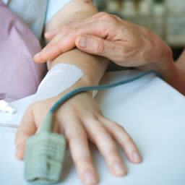
M4-A
Living with Lymphoma
Coping with childhood lymphoma
  Challenges for children of any age:
    Being in an unfamiliar environment
    Having to take medications or undergoing procedures that may be uncomfortable
    Coping with fear and other feelings related to changes in appearance (hair loss, weight gain).
  The extent of the child’s distress depends on his/her age and personality
  Maintaining a supportive yet matter-of-fact attitude may help the child to adjust to and accept these changes
  Survival rates for children have improved significantly during the last several decades
Source: www.llscanada.org

Slide 14
M4-A
Living with Lymphoma
Patient preferences for obtaining information
  The majority of patients want to be informed about their cancer
  Patients vary in how much and what type of information they want, and their preferences may change during their illness
  Patients are interested in the personal and psychosocial aspects of their illness with/without interest in the medical aspects
  Information-seeking may be a coping mechanism in patients with cancer, particularly in the younger age-group
    Patients need guidance on reliable Internet sources of information
  Elderly patients often do not want to receive medical details about their disease
  Avoiding information, in particular about the prognosis, can be a strategy to maintain hope
Source: Leydon et al., 2000; Dias et al., 2003; Friis et al., 2003; Penson et al., 2002a

Slide 15
M4-A
Living with Lymphoma
Cancer Patients’ Ranking of Psychosocial Needs: Information
 | Percentage of patients rating item important or very important
Information, Overall | 80%
Information about treatment plans Information about what to expect Information about medication and side-effects Advice on what services and help are available Access to other sources of information | 86% 86% 82% 77% 67%
Source: McIllMurrey et al., 2001.

Slide 16
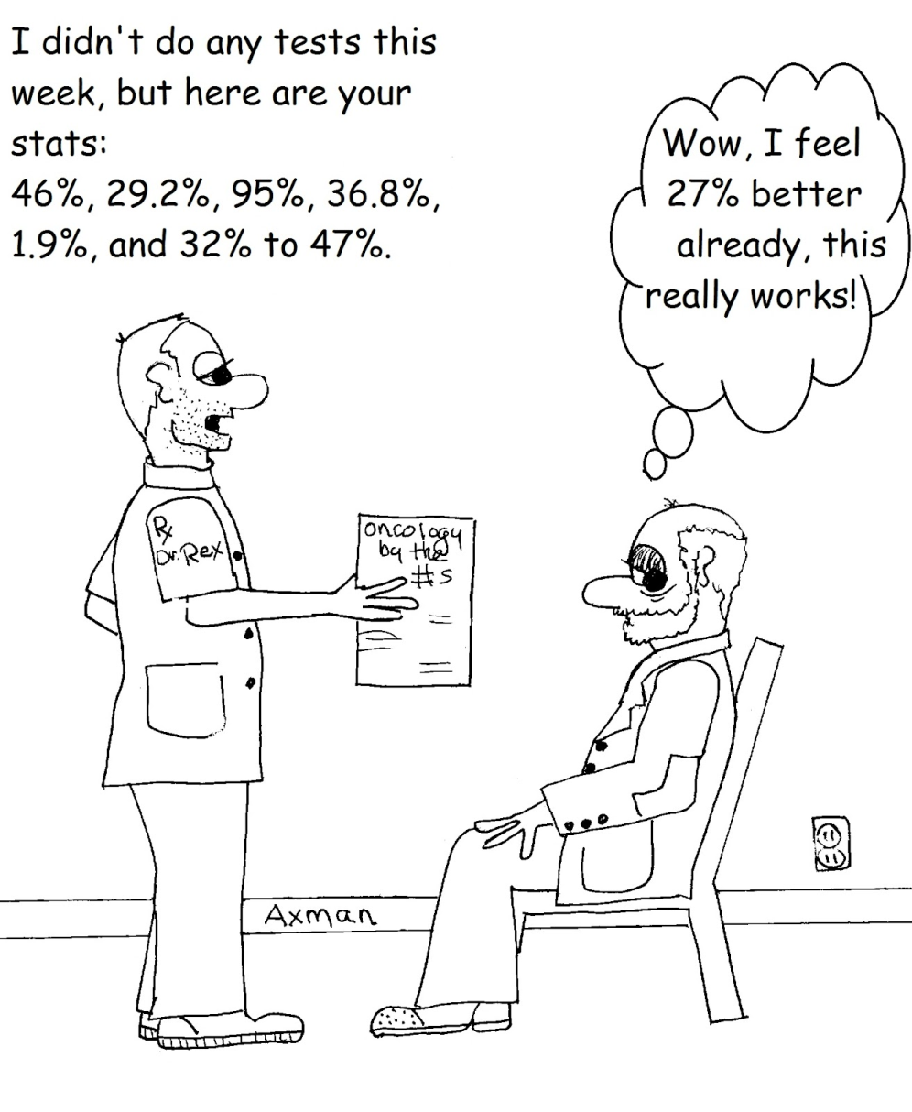
M4-A
Living with Lymphoma
Source: www.cancer-clinical-trials.com

Slide 17
M4-A
Living with Lymphoma
Open patient-healthcare provider communication
  Critical for developing a therapeutic relationship, and implementing a treatment plan
  Requires mutual trust and respect and strong listening skills
  The majority of lymphoma patients would discuss physical and daily functioning issues, however:
    25% of patients are reluctant to bring up emotional issues
    50% of patients would not initiate discussion on social and sexual problems
    These discussions need to be initiated by healthcare providers
Source: Dias et al., 2003; Arora et al., 2013

Slide 18
M4-A
Living with Lymphoma
2. The impact of lymphoma on the patient’s life
  Side effects of lymphoma treatment
  Complications of lymphoma and other long-term challenges
  How to deal with the disease within their family and/or relationships
  Impact on daily activities, looking after themselves
  Other day-to-day issues: work and finances
  Travel and holidays

Slide 19
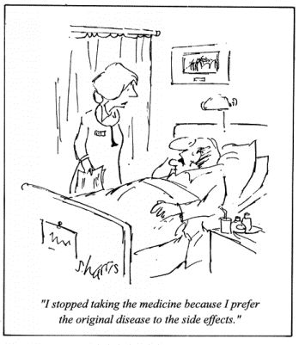
M4-A
Living with Lymphoma
Side effects of lymphoma treatment
  Intense medical treatments that can significantly compromise quality of life
  Sometimes the worst experience for a patient is just getting through a day, hour, or minute of their lives because of the fear, pain, or other side effects of treatment
  Details on individual side effects are provided in Module 3.
Source: Penson et al., 2004

Slide 20
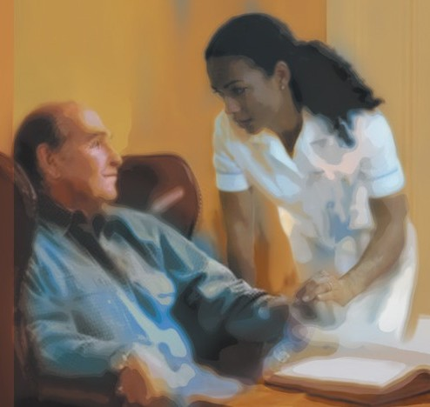
M4-A
Living with Lymphoma
Complications of lymphoma and other long-term challenges
  For many patients, survival is a saga of remission and rehabilitation, followed perhaps by re-diagnosis and more treatment
  Patients must learn to monitor their health in a new way and learn what is healthy and safe for their new, modified lives
  Patients need health care providers who understand the challenges of long-term survival and do not minimize or dismiss their concerns and symptoms
Source: Leigh 2006

Slide 21
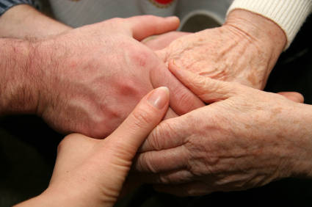
M4-A
Living with Lymphoma
Dealing with the disease within family/relationships
  Lymphoma diagnosis is life-changing for patients and their families
  Support from family and friends is very important even if the patient feels it is not helpful at times
  Relationships may go through difficult times and even change or end during the course of the disease
  The usual roles in a partnership (e.g., decision making, paying bills, taking care of the children) may need to shift and patients should not feel guilty about this
  Family members may react differently to the stress
  Tip for patients:
    Be honest about your feelings and discuss your needs and expectations with your partner and family members.

Slide 22
M4-A
Living with Lymphoma
Cancer Patients’ Ranking of Psychosocial Needs: Support Network and Identity
 | Percentage of patients rating item important or very important
Support Network, Overall | 75%
Support from family Support from friends Support from care professionals Someone to talk to Support from neighbours | 89% 85% 77% 69% 56%
Identity, Overall | 47%
Help in maintaining independence in the face of illness Help in maintaining a sense of control in my life Support in dealing with changes in my body or the way I look Support in dealing with any changes in the way others see me Support in dealing with any changes in my sense of who I am | 60% 52% 51% 37% 35%
Source: McIllMurrey et al., 2001.

Slide 23

M4-A
Living with Lymphoma
Impact on daily activities, looking after themselves
  Patients may feel too tired to complete normal daily activities or to do even simple things, such as watching TV due to fatigue
  Causes of fatigue:
    Lymphoma itself or its treatment (chemotherapy, radiotherapy)
    Other treatment (antiemetics, antidepressants)
    Anaemia, Stress
    Anxiety, feeling depressed
    Poor diet
  Tip for patients:
    Accept any help that your family and friends offer – it will not only make your cancer journey easier, but will also bring you closer

Slide 24
M4-A
Living with Lymphoma
Causes of Fatigue in Cancer Patients
Source: www.cancernetwork.com

Slide 25
M4-A
Living with Lymphoma
Cancer Patients’ Ranking of Psychosocial Needs: Practical Issues
 | Percentage of patients rating item important or very important
Practical Issues, Overall | 36%
Help with any distressing symptoms Help with transport Help in dealing with any tiredness Advice about food and diet Help with housework Help with getting out and about socially Help with financial matters Help in filling out forms Help with child care | 49% 47% 41% 39% 35% 34% 23% 21% 7%
Source: McIllMurrey et al., 2001.

Slide 26

M4-A
Living with Lymphoma
Work and finances
  Several years of expensive medical care, while cutting back on work or unable to work creates a financial stress that increases the emotional burden of the disease.
  It is important to reassure the patient that there are laws that protect them from losing their jobs because of their medical condition.

Slide 27

M4-A
Living with Lymphoma
Travel and holidays – Advice for Patients:
  Discuss holiday plans with your health care team!
  Do not interrupt your ongoing treatment!
  Find out what medical facilities are available at your travel destination.
  Travelling to some parts of the world may have additional risks
    exposure to new infections, skin damage from sun exposure, reactions from insect bites, etc.
  Live vaccines may not be safe for you
  You may be denied travel insurance even if you are in remission
  If travelling within Europe, obtain a European Health Insurance Card (EHIC), to receive emergency treatment in any EU country

Slide 28
M4-A
Living with Lymphoma
3. Lifestyle considerations
  Healthy eating
  Exercise
  Sleeping
  Sexual difficulties
  Fertility
  Pregnancy

Slide 29

M4-A
Living with Lymphoma
Healthy eating
  Patients need to eat to maintain their weight and keep up their strength to deal with the side effects of treatment
  Regular healthy diet
    Reduced amounts of red meat and eating more lean cut meat
    Increased amounts of fresh fruits, vegetables, and other sources of fiber
    Reducing sugar and salt, minimizing alcohol use
    Drinking plenty of water, especially during chemotherapy
  Special diets are often recommended
    E.g. extra protein or extra calories
  Note: some diets claim to cure cancer; however there is no scientific evidence to prove that any particular diet cures lymphoma
Source: www.cancer.gov; www.lymphomalife.net; www.lymphomas.org.uk

Slide 30
M4-A
Living with Lymphoma
Exercise
  Regular gentle exercise may help dealing with symptoms of lymphoma and side effects of treatment
  Can improve appetite, reduce the feelings of depression and anxiety, and improve quality of life
  Walking, or simple stretching and relaxation exercises are the most accessible and easy to manage for most patient
  Tips for patients:
    Adapt your exercise routine according to how well you are
    Discuss the risks of some types of exercising with a HCP, particularly:
      If you have a central line, Hickman® line, or PICC line inserted
      If you are anemic, feel dizzy, or have low WBC count, shortness of breath, an irregular heartbeat, pain, or fever
      Patients with low WBC count should not be swimming in public pools or engage in contact sports due to the increased risk of infections.
Source: www.lymphomas.org.uk

Slide 31

M4-A
Living with Lymphoma
Difficulty Sleeping
  Difficulty falling asleep and/or waking up during the night
  Common side effect of corticosteroid-containing chemotherapy regimens (e.g. CHOP) and radiation therapy
  Disrupted sleep may occur months to years following therapy
  Tips for patients:
    Regular light exercise, relaxation techniques may help reduce sleep problems
    Maintaining a regular sleeping routine
    Avoid caffeine, alcohol, any distractions before going to bed
    Have a warm bath before going to bed
Source: Sitzia et al., 1997; Kim et al., 2009; Mulrooney et al., 2008

Slide 32
M4-A
Living with Lymphoma
Sexual difficulties
  Lymphoma treatments can significantly affect sexual function
  Male and female patients may face various difficulties and may respond differently to sexual dysfunction
  Cultural differences may strongly influence a patient’s response to loss of sexual function
  Healthcare providers should ask about sexual difficulties, because patients will not volunteer sexual issues spontaneously
  It is very important for healthcare providers to be sensitive to different patient expectations and biases, and remain supportive and nonjudgmental
  When sexual intercourse is no longer possible, couples should be encouraged to enrich their relationship in other ways.
Source: Penson et al., 2000

Slide 33
M4-A
Living with Lymphoma
Fertility and Pregnancy
  Ovarian toxicity is an important and common long-term side effect of curative chemotherapy and radiotherapy
  The impact of sterilization and early menopause on the quality of life and self-esteem of young patients is detrimental
  Young women should be counselled on available fertility preserving options before starting anticancer treatments
  For males, sperm banking may be planned before treatment
  Lymphoma treatment can be complicated by pregnancy and can also harm the foetus
  There is no particular time-point when it is considered optimal to allow patients to become pregnant following cancer diagnosis.
    The timing should consider the time of completion of therapy, risk of relapse, and the age and ovarian function of the patient
Source: Meirow and Nugent, 2001; Peccatori et al., 2013

Slide 34
M4-A
Living with Lymphoma
Case Studies - Overview
  These case studies demonstrate how different aspects of lymphoproliferative disease affect patients
  In the first section of the case study you will find some key background information about:
    Age
    Time since diagnosis
    Type of Lymphoma
    Type SCT
    Treatment Programme
    Individual experiences during the illness trajectory
    Other medical conditions
  In the second part, you will be confronted with real individual experiences during the illness trajectory of each patient.
  The last section will present the patient situation in totality (e.g. ethical aspect, symptoms, social condition).

Slide 35
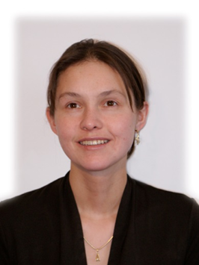
M4-A
Living with Lymphoma
Case Study 1: Patient Florence*, 30 years old
  When she was 20 years old, her general practitioner suggested a visit to a dermatologist because of itching, fatigue (she fell asleep during school lessons), and extreme weight loss (> 10% of her body weight).
  9 months after the onset of these systemic symptoms she noted a swelling on her neck. On examination the swelling appeared as a lymphadenopathy with increased consistency. Based on biopsy and histological analysis, a diagnosis of Hodgkin Lymphoma Stage II B (nodal lymphocyte predominant) was made.
  Within 5 years after standard dose chemotherapy, the patient underwent autologous SCT, followed by allogeneic STC with a sibling donor (her brother).
* Pseudonym used to protect patient confidentiality

Slide 36
M4-A
Living with Lymphoma
Experiences during Florence’s illness trajectory
  Physical and cognitive activity was significantly lower after SCT.
  The prospect of infertility was discussed at the beginning of treatment, and did not gain further importance at the time of the SCT. Currently, Florence and her husband have no plans to have children.
  During the first 100 days after SCT, the long travels from a rural area to the Central Hospital for follow-up visits caused severe fatigue.
  Florence’s family provided ongoing emotional support. Her husband was suffering a lot due to her disease, but he always cared for her.
  Some of her friends had problems dealing with her disease and stopped contacting her for a while or completely.
  A good rapport and regular contact with health care professionals was helpful, particularly during the transplantation time.

Slide 37
M4-A
Living with Lymphoma
Discussion
  What are the most common symptoms at the time Hodgkin’s Lymphoma is diagnosed?
  What percentage of patients with Hodgkin’s Lymphoma can be cured nowadays?
  Florence’s family provided great support. How can you integrate and support family members in the patient’s cancer journey?
  While advising the patient try to prevent excessive questions / mental overload with good communication skills (psychological support).
  The prospect of not being able to have children was not a significant issue in Florence’s case, but it may be for other patients. How would you advise a patient about the available options to conserve fertility after chemotherapy?

Slide 38

M4-A
Living with Lymphoma
Case Study 2: Patient Andrew*, 45 years old
  He first contacted his general practitioner due to painless swollen lymph nodes on his neck, when he was 23 years old. A blood test showed lymphocytosis in the absence of anemia or thrombocytopenia, and a tentative diagnosis of CLL was made.
  It took several months to confirm CLL/SLL as the final diagnosis.
  After 7 years of watch and wait, during a 2 ½ week cycling tour, Andrew suffered from a strong flu.
  After returning home, his general practitioner requested an emergency admission to the hospital, where after standard dose chemotherapy he was subjected to an autologous SCT.
* Pseudonym used to protect patient confidentiality

Slide 39
M4-A
Living with Lymphoma
Experiences during Andrew’s illness trajectory
  Despite being in good general condition, after the diagnosis, many thoughts regarding his illness and its meaning, dealing with the disease and the chance for survival, informing friends and questions about dying became his priority.
  Playing music gave Andrew strength and stability.
  Returning to normal life, including starting to work again was very important to him.
  Further complementary medicine (kinesiology) has been supporting his health over the past 15 years.
  A big issue for Andrew was how to tell his friends and colleagues about his illness and how to deal with their reaction. He missed getting advice on how to communicate with people about his disease.

Slide 40
M4-A
Living with Lymphoma
Experiences during Andrew’s illness trajectory
  To better understand the disease and what patients can expect during transplantation, good visual information (e.g. a video) would be very helpful.
  The frequent changes in physicians and nurses during the inpatient time added to the stress level.
  “Sometimes, physicians were only interested in my case instead in me”.
  Fears of getting acute infections and other serious side effects were the main focus after transplantation.

Slide 41
M4-A
Living with Lymphoma
Discussion
  How can you find out the needs of a patient in a watch and wait situation and how can you support him/her?
  What issues were hindering Andrew’s communication about his situation with his social environment and what might have helped him overcome these issues?
  What are important points to explain to the patient regarding SCT after the physician informational talk?
  Andrew had fears of getting an acute infection. Develop a plan to improve awareness about infection risks (e. g. contact with children and animals, public transport, indoor and outdoor activities)

Slide 42
M4-A
Living with Lymphoma
Word search
N | I | G | H | T | S | W | E | A | T | I | N | G | D | I | T | N | M | S | H
R | O | M | I | D | S | A | W | Q | F | S | L | Y | W | X | R | U | V | C | A
U | S | U | R | G | I | C | A | L | M | A | S | K | U | X | A | M | N | I | E
E | 8 | S | W | F | I | C | H | E | I | S | H | E | Q | P | N | M | Y | X | N
W | P | 0 | D | I | E | S | C | H | A | K | C | R | U | T | S | N | S | P | G
E | F | Y | - | R | J | V | U | T | C | I | R | K | N | O | P | C | C | R | O
I | L | S | U | 9 | C | V | E | U | O | N | E | A | G | L | L | R | H | T | O
G | A | N | E | U | 0 | R | O | R | P | G | L | P | T | J | A | Y | U | L | D
H | N | S | A | Z | U | % | B | P | I | A | S | L | U | I | N | O | T | O | C
T | Z | E | S | S | T | U | I | B | N | C | O | A | R | A | T | C | Z | Y | O
L | S | Q | I | T | C | H | I | N | G | T | W | S | D | F | P | O | E | C | M
O | N | T | D | W | U | R | E | H | F | I | T | I | G | A | R | N | C | H | M
S | E | R | E | S | T | E | A | Z | E | V | U | A | L | C | O | S | U | Z | U
S | F | X | E | R | U | T | R | S | A | E | N | B | I | T | C | E | L | T | N
I | L | I | F | P | I | N | Y | A | R | L | Q | D | U | S | E | R | G | S | I
K | U | P | F | E | Z | L | C | U | S | Y | F | A | E | H | D | V | D | B | C
N | O | U | E | S | A | L | I | W | A | S | S | E | R | E | U | A | U | I | A
U | R | N | C | B | I | O | L | T | R | E | R | S | Z | E | R | T | T | E | T
T | A | M | T | L | L | E | N | T | Y | E | C | H | E | T | E | I | P | A | I
R | E | I | S | T | K | D | C | V | N | I | U | O | K | D | E | O | X | W | O
I | V | F | A | M | I | L | Y | C | A | R | E | K | T | I | V | N | H | O | N
T | M | E | D | I | C | A | T | I | O | N | A | D | H | E | R | E | N | C | E
I | E | L | S | T | C | D | O | P | L | A | T | E | E | F | F | E | C | T | S
O | O | Q | E | S | W | O | L | L | E | N | L | U | M | P | S | G | D | P | E
N | E | S | C | O | N | F | I | D | E | N | C | E | B | A | S | E | U | R | L
Words can be found horizontally, vertically, or diagonally

Slide 43
M4-A
Living with Lymphoma
Word search
swollen lumps
weight loss
fever
night sweating
itching
80 – 90%
family care
good communication
cryoconservation
sterility
asking actively
confidence base
coping with fears
side and late effects
transplant procedure
aplasia
nutrition
medication adherence
fact sheet
surgical mask
N | I | G | H | T | S | W | E | A | T | I | N | G | D | I | T | N | M | S | H
R | O | M | I | D | S | A | W | Q | F | S | L | Y | W | X | R | U | V | C | A
U | S | U | R | G | I | C | A | L | M | A | S | K | U | X | A | M | N | I | E
E | 8 | S | W | F | I | C | H | E | I | S | H | E | Q | P | N | M | Y | X | N
W | P | 0 | D | I | E | S | C | H | A | K | C | R | U | T | S | N | S | P | G
E | F | Y | - | R | J | V | U | T | C | I | R | K | N | O | P | C | C | R | O
I | L | S | U | 9 | C | V | E | U | O | N | E | A | G | L | L | R | H | T | O
G | A | N | E | U | 0 | R | O | R | P | G | L | P | T | J | A | Y | U | L | D
H | N | S | A | Z | U | % | B | P | I | A | S | L | U | I | N | O | T | O | C
T | Z | E | S | S | T | U | I | B | N | C | O | A | R | A | T | C | Z | Y | O
L | S | Q | I | T | C | H | I | N | G | T | W | S | D | F | P | O | E | C | M
O | N | T | D | W | U | R | E | H | F | I | T | I | G | A | R | N | C | H | M
S | E | R | E | S | T | E | A | Z | E | V | U | A | L | C | O | S | U | Z | U
S | F | X | E | R | U | T | R | S | A | E | N | B | I | T | C | E | L | T | N
I | L | I | F | P | I | N | Y | A | R | L | Q | D | U | S | E | R | G | S | I
K | U | P | F | E | Z | L | C | U | S | Y | F | A | E | H | D | V | D | B | C
N | O | U | E | S | A | L | I | W | A | S | S | E | R | E | U | A | U | I | A
U | R | N | C | B | I | O | L | T | R | E | R | S | Z | E | R | T | T | E | T
T | A | M | T | L | L | E | N | T | Y | E | C | H | E | T | E | I | P | A | I
R | E | I | S | T | K | D | C | V | N | I | U | O | K | D | E | O | X | W | O
I | V | F | A | M | I | L | Y | C | A | R | E | K | T | I | V | N | H | O | N
T | M | E | D | I | C | A | T | I | O | N | A | D | H | E | R | E | N | C | E
I | E | L | S | T | C | D | O | P | L | A | T | E | E | F | F | E | C | T | S
O | O | Q | E | S | W | O | L | L | E | N | L | U | M | P | S | G | D | P | E
N | E | S | C | O | N | F | I | D | E | N | C | E | B | A | S | E | U | R | L
Words can be found horizontally, vertically, or diagonally

Slide 44
M4-A
Living with Lymphoma
Word search
Did you find the right answers?...
Here’s the solution!
N | I | G | H | T | S | W | E | A | T | I | N | G | D | I | T | N | M | S | H
R | O | M | I | D | S | A | W | Q | F | S | L | Y | W | X | R | U | V | C | A
U | S | U | R | G | I | C | A | L | M | A | S | K | U | X | A | M | N | I | E
E | 8 | S | W | F | I | C | H | E | I | S | H | E | Q | P | N | M | Y | X | N
W | P | 0 | D | I | E | S | C | H | A | K | C | R | U | T | S | N | S | P | G
E | F | Y | - | R | J | V | U | T | C | I | R | K | N | O | P | C | C | R | O
I | L | S | U | 9 | C | V | E | U | O | N | E | A | G | L | L | R | H | T | O
G | A | N | E | U | 0 | R | O | R | P | G | L | P | T | J | A | Y | U | L | D
H | N | S | A | Z | U | % | B | P | I | A | S | L | U | I | N | O | T | O | C
T | Z | E | S | S | T | U | I | B | N | C | O | A | R | A | T | C | Z | Y | O
L | S | Q | I | T | C | H | I | N | G | T | W | S | D | F | P | O | E | C | M
O | N | T | D | W | U | R | E | H | F | I | T | I | G | A | R | N | C | H | M
S | E | R | E | S | T | E | A | Z | E | V | U | A | L | C | O | S | U | Z | U
S | F | X | E | R | U | T | R | S | A | E | N | B | I | T | C | E | L | T | N
I | L | I | F | P | I | N | Y | A | R | L | Q | D | U | S | E | R | G | S | I
K | U | P | F | E | Z | L | C | U | S | Y | F | A | E | H | D | V | D | B | C
N | O | U | E | S | A | L | I | W | A | S | S | E | R | E | U | A | U | I | A
U | R | N | C | B | I | O | L | T | R | E | R | S | Z | E | R | T | T | E | T
T | A | M | T | L | L | E | N | T | Y | E | C | H | E | T | E | I | P | A | I
R | E | I | S | T | K | D | C | V | N | I | U | O | K | D | E | O | X | W | O
I | V | F | A | M | I | L | Y | C | A | R | E | K | T | I | V | N | H | O | N
T | M | E | D | I | C | A | T | I | O | N | A | D | H | E | R | E | N | C | E
I | E | L | S | T | C | D | O | P | L | A | T | E | E | F | F | E | C | T | S
O | O | Q | E | S | W | O | L | L | E | N | L | U | M | P | S | G | D | P | E
N | E | S | C | O | N | F | I | D | E | N | C | E | B | A | S | E | U | R | L
Words can be found horizontally, vertically, or diagonally

Slide 45
M4-A
Living with Lymphoma
Answers to Previous Questions (1)
  Swollen lumps; Weight loss (more than 10% of usual weight); Fever; night sweating; Itching (see also Module 1)
  Between 80 – 90%; depending on the stage of the diagnosis: for early stage about 98% for advanced stage 80% of the cases (see also Module 1)
  Family care
  Good communication in relationship or/and with relatives
  Information and discussion on cryoconservation and the true risk of sterility
Words in bold were included in the word search

Slide 46
M4-A
Living with Lymphoma
Answers to Previous Questions (2)
  Asking actively, give support in this withstand
  Good relationship, open communication, confidence base, acceptance of the illness, coping with fears and uncertainty
  Side and late effects, transplant procedure, aplasia, nutrition, medication adherence
  Hand out a fact sheet, surgical mask, ask actively on the most important points (see question above), telephone follow-up
Words in bold were included in the word search

Slide 47
M4-A
Living with Lymphoma
Group Discussion
  What are the most difficult challenges of living with lymphoma?
  What are the easiest challenges to overcome?
  What tips / suggestions have you learned from patients about living with lymphoma that others might find useful?
  With what aspects of living with lymphoma can patient support groups help?

Slide 48
Module 4B:
The role of nurses in patient support

Slide 49

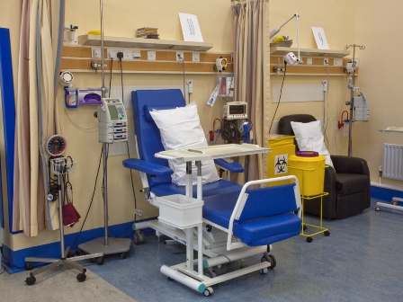

M4-B
The role of nurses in patient support
Assessments and follow-up
Treatment administration and management of side effects
Providing information, advice and emotional support
Source: Liptrott S. IEO 2009; www.mskcc.org

Slide 50

M4-B
The role of nurses in patient support
Multiple roles:
  Patient assessment
  Delivery of nursing interventions
  Patient education
  Coordination and evaluation of care.
Nursing care plan for patients
  Developed in response to patient needs, identified at time of initial assessment and during ongoing assessments.
Collaborative care plan
  Prepares the patient and family for the proposed treatment
  Assists in the patient’s understanding of the disease, treatment and possible side-effects
  Facilitates psychological well-being and promotes compliance with treatment
Source: www.hse.ie

Slide 51
M4-B
The role of nurses in patient support
Patient education
  Pivotal role of nurses in providing education
  Helps patients cope with lymphoma, including its complications and impact on quality of life
  Begins before treatment start and continues to long term care
  Should include advice about reliable vs unreliable sources of information
  Nurses can also help facilitate discussion with the physician about the patient's illness and treatment plans
Source: www.hse.ie

Slide 52
M4-B
The role of nurses in patient support
Providing Emotional Support
  Integral part of the nursing role.
  Helps to relieve the patient’s psychosocial stress
  May facilitate ameliorative action being taken by the patient or informal carer
  In order to provide such support, nurses should understand the emotional toll of the cancer journey on the patient
  The emotional support does not end with the completion of treatment
  May turn into support of the bereaved
Source: www.hse.ie

Slide 53
Module 4C:
Challenges of Haematology/Oncology Nursing

Slide 54
M4-C
Challenges of Haematology/Oncology Nursing
General Considerations and Gaps
  Cancer nursing is acknowledged as a particularly stressful occupation
  Causes of stress often include:
    Complex healthcare states and comorbidities
    Increasing patient acuity and patient expectations of care
    Technological advances requiring increasingly sophisticated nursing skills
    Decreased length of hospital admissions
    The necessity of dealing with the dying process
  Lack of evidence-based, standardized nursing guidelines
  Patient and family / care provider education gaps
Source: Barnard et al., 2006

Slide 55
M4-C
Challenges of Haematology/Oncology Nursing
Coping with Emotional Stress
  Dealing with patients’ suffering is one of the major contributors to professional burnout
  Staff often identifies closely with patients; however, while their concern for a critically ill patient can bring joy and meaning to their work, this can also complicate their ability to deal with the patient’s deterioration and impending death
  Therefore, in addition to patients’ and families’ needs, the needs of nurses and other professionals caring for dying and distressed patients also need to be considered
    It is vital to have a colleague support system and a forum for discussion of these issues in order to defuse distress and reassure staff that they are doing all that can be done as professionals and caregivers
Source: Ramirez et al., 1996; Lintz et al., 1999

Slide 56
M4-C
Challenges of Haematology/Oncology Nursing
Working in Multidisciplinary Teams
  There is an increasing need for a team of medical specialists working in unison to deliver optimal medical care
  This coordination may maximize the technical synergy of care, but can also challenge inter-professional and interdisciplinary connections, and increase the risk of communication breakdowns and conflicts between staff
  Communication challenges with patients who are new immigrants may be overcome by integrating professional medical interpreters into the multidisciplinary team
  Innovative coordinated teams may include a hematologist, physician assistant, nurse/research coordinator, social worker, pharmacist, and even the patient, and referring community oncologist, to assist patients throughout their cancer journey.
Source: Penson et al., 2006; Schapira et al., 2008; Holloway et al., 2012

Slide 57
M4-C
Challenges of Haematology/Oncology Nursing
Dealing with Special Situations
  Some patients may contemplate or attempt suicide
    Learning that a patient committed suicide can devastate his/her caregivers
    They may question whether more could have been done to prevent this outcome
  Patient may also ask their healthcare provider for guidance or help in ending their lives.
    This may put the nurse in a very uncomfortable position
  Caring for colleagues who develop cancer presents with multiple caregiver-patient issues
    Patient's level of medical knowledge;
    Technical, informational, emotional, and hierarchical issues
    Emotional stress related to sharing an accurate prognosis
Source: O’Shea et al., 1999; Penson et al., 2001

Slide 58
Module 4D:
Patient Support Services and Educational Resources

Slide 59
M4-D
Patient Support Services and Resources
Potential patient support services at the institutional level
  Call-in information service where patients (or their parent)
  Language services (e.g. professional healthcare interpreter) who speaks the patient’s native language or uses sign language
  Free web-based education programs presented by experts
  Free education and support materials for patients (including children), their families, and primary care providers
  Extensive list of resources for patients and families regarding important aspects of their disease
    Financial assistance, counselling, transportation, and other needs
  Information on how to participate in a clinical trial
  Peer-to-peer support;
  Assistance with financial issues

Slide 60
M4-D
Patient Support Services and Resources
Patients Associations and Support Groups
  Being diagnosed with a potentially fatal illness is a life-changing event that is often best understood by other cancer patients.
  Patients struggling with similar life issues can provide each other with a sense of solidarity and reassurance
  Supportive-expressive group therapy has been shown to reduce anxiety, improve mood, and reduce perception of pain, yet it is often underutilized due to cultural or transportation barriers.
  Internet-based support groups offer similar benefits to patients compared to traditional ones, including empowering the participants, reducing isolation, providing a community of support, and providing a forum for patients to actively help others cope.
Source: Spiegel, 2001; Klemm and Hardie, 2002

Slide 61
M4-D
Patient Support Services and Resources
Patient Education Websites
  The Lymphoma Coalition: http://www.lymphomacoalition.org
  Ho/noho: http://www.lymphome.ch
  France Lymphome Espoir: http://www.francelymphomeespoir.fr
  Deutsche Leukamie & Lymphom-Hilfe eV Germany: http://www.leukaemie-hilfe.de/startseite.html
  Patiëntenvereniging voor Lymfomen: http://lymfklierkanker.be/nl
  The Lymphoma Information Network: http://www.lymphomainfo.net
  The Lymphoma Research Foundation: http://www.lymphoma.org
  The Leukemia & Lymphoma Society: http://www.lls.org
    The LLS publication Lymphoma Guide: Information for Patients and Caregivers is accessible at: http://www.lls.org/content/nationalcontent/resourcecenter/freeeducationmaterials/lymphoma/pdf/lymphomaguide.pdf

Slide 62
Module 4
References (1)
Arora NK et al. J Clin Oncol. 2013 Nov 1;31(31):3964-70.
Barnard D et al. Cancer Nurs. 2006 Jul-Aug;29(4):338-45.
Dias L et al. Oncologist. 2003;8(6):587-96.
Friis LS et al. Support Care Cancer. 2003 Mar;11(3):162-70.
Holloway S et al. Clin Lymphoma Myeloma Leuk. 2012 Apr;12(2):88-93.
Kim E et al. Support Care Cancer. 2009 Nov;17(11):1383-91.
Klemm P et al. Oncol Nurs Forum 2002;29:E45-E54.
Leigh S et al. Am J Nurs. 2006 Mar;106(3 Suppl):12-4.
Leydon GM et al. West J Med. 2000 Jul;173(1):26-31.
Lintz KC et al. Oncologist. 1999;4(1):70-6.
McIllmurray MB et al. Eur J Cancer Care (Engl). 2001 Dec;10(4):261-9.
Meirow D et al. Hum Reprod Update. 2001 Nov-Dec;7(6):535-43.
O'Shea EM et al. Oncologist. 1999;4(2):122-7.
Pattison NA et al. J Relig Health. 2011 Sep;50(3):731-42.
Peccatori FA et al. Ann Oncol. 2013 Oct;24 Suppl 6:vi160-70.

Slide 63
Module 4
References (2)
Penson RT et al. Oncologist. 2002a;7(6):555-68.
Penson RT et al. Oncologist. 2000;5(4):336-44.
Penson RT et al. Oncologist. 2006 May;11(5):520-6.
Penson RT et al. Oncologist. 2005 Feb;10(2):160-9.
Penson RT et al. Oncologist. 2001;6(2):197-204.
Penson RT et al. Oncologist. 2004;9(2):217-25.
Ramirez AJ et al. Lancet 1996;347:724 –728.
Randall TC et al. Palliat Med. 2005 Dec;19(8):594-601.
Schapira L et al. Oncologist. 2008 May;13(5):586-92.
Sitzia J et al. Cancer Nurs. 1997 Dec;20(6):430-9.
Spiegel D et al. N Engl J Med 2001;345:1767-1768.

Slide 64
M4
Questions & Answers
  Questions from Training Participants?

