Slide 1
Lymphoma Learning Programme
for Nurses and
Allied Healthcare Professionals
September/2014

Slide 2
Module 3:
Consequences and Complications of Lymphoma and its Treatment

Slide 3
Module 3 Objectives
After completing this module, participants should be able to:
  Describe the impact of the disease and its complications on patients’ quality of life (QoL)
  Describe the short- and long-term side-effects of lymphoma treatment, their impact on QoL and how to prevent and/or manage them
  Provide practical tips for dealing with symptoms and side-effects of lymphoma treatments
  Explain the long-term complications of the disease and importance of follow-up
  Recognize the nurses’ role in the long-term follow-up and patient support and apply this knowledge to daily practice

Slide 4
Module 3 Overview
Lymphoma symptoms and their management
Side effects of lymphoma treatment
Managing the side-effects of lymphoma treatment
Drug interactions with oral therapies
Other treatment considerations
Long-term follow-up

Slide 5
Module 3A:
Lymphoma Symptoms and
their Management

Slide 6
M3-A
Lymphoma Symptoms
General symptoms
  Fatigue
  Persistent generalised itchiness
  Pain/symptoms due to lymphoma growth
    Examples:
      In the gut, leading to abdominal pain, indigestion or diarrhoea
      In the lung, leading to cough, dyspnoea and chest pain

Slide 7

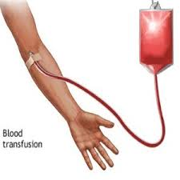
M3-A
Managing Lymphoma Symptoms
Managing Fatigue
Management options
If anaemic:
  Blood transfusions
  Drug therapy
  (e.g. erythropoietin)
Practical tips for patients
Eat a healthy, well-balanced diet
Regular gentle exercise
Adequate rest
Avoid caffeine just before bedtime

Slide 8

M3-A
Managing Lymphoma Symptoms
Managing Itchiness
Management options
Topical corticosteroids
Antihistaminics (hydroxyzine or diphenhydramine), doxepin
Serotonin-inhibitors (paroxetine, mirtazapine)
Cold compresses applied on the affected area.
  Note: warm or hot compresses will just irritate the skin further!
Source: http://www.cancerresearchuk.org

Slide 9

M3-A
Managing Lymphoma Symptoms
Managing Itchiness
Practical tips for patients
Take shorter (<30 minute) baths in lukewarm water instead of long, hot baths
Use mild or no soaps
Pat your skin dry with a towel rather than rubbing
Use cotton or linen sheets and wear cotton clothes instead of wool or synthetic fabrics
Keep an even, cool temperature in your room
Avoid long exposure to the sun
Moisturise your skin straight after you bathe and several times a day with scentless lotions
Apply the moisturiser in the same direction as your hair grows
Avoid lanolin based lotions
Keep your nails short
Source: http://www.cancerresearchuk.org

Slide 10
M3-A
Managing Lymphoma Symptoms
Cancer Pain: Multidimensional Phenomenon
Functional
Social
Physical
Emotional
Spiritual
Source: NCCN; Caraceni and Portenoy, 1999

Slide 11

M3-A
Managing Lymphoma Symptoms
Managing Pain
Management options
WHO 3-step analgesic ladder
Acetaminophen, nonsteroidal anti-inflammatory drugs (NSAIDs)
Opioids
  Morphine, hydromorphone, codeine, oxycodone, fentanyl, oxymorphone, hydrocodone, methadone, levorphanol
  Meperidine, tapentadol, tramadol
Adjuvant drugs
  Antidepressants, local anaesthetics, anticonvulsants, corticosteroids, bisphosphonates
Physical Interventions
  Heat/cold, exercise, transcutaneous electrical nerve stimulation (TENS)
Integrative Interventions
  Massage, acupuncture
Cognitive-Behavioral & Psychosocial Interventions
  Relaxation, hypnosis, psychotherapy, patient/family education, support groups, pastoral counselling
Source: www.cancer.gov (NCI)

Slide 12
M3-A
Managing Lymphoma Symptoms
Tools for Assessing Cancer Pain
Adapted from: Ripamonti et al., 2012

Slide 13
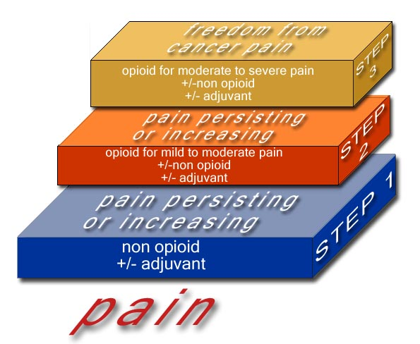
M3-A
Managing Lymphoma Symptoms
Managing Cancer Pain: WHO Analgesic Ladder
Source: cancerpain.org.uk

Slide 14
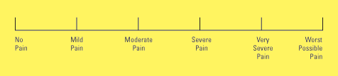
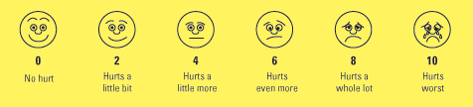
M3-A
Managing Lymphoma Symptoms
Managing Pain
Practical tips for patients
Work with your doctor to develop a pain management plan
Notify your doctor right away if you have new or worsening pain
Take your pain medication regularly, as instructed by your doctor.
  Do not skip doses, or wait for the pain to get worse
  Take your pain medication even when you are not feeling the pain. Once you feel pain, it is more difficult to get it under control.
Let your doctor know if you experience side effects of pain medication (e.g. constipation, nausea and vomiting, drowsiness)
Keep a record of your pain and share it with your doctor
  Location(s) of your pain, how it feels (e.g. burning, tingling, sharp/dull, throbbing or steady), what makes it feel better or worse, etc.
Source: www.cancercenter.com; www.cancer.gov

Slide 15
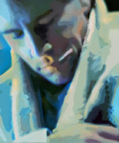
M3-A
Lymphoma Symptoms
“B” Symptoms:
  Fever (>38°C)
  Night sweats
  Weight loss (>10% in 6 months)
  and loss of appetite

Slide 16
M3-A
Managing Lymphoma Symptoms
Managing Fever and Night Sweats
Management options
Paracetamol
Hydration
Relaxation techniques
Antipyretics and antihistaminics for fever associated with monoclonal antibody therapy
Practical tips for patients
Regular gentle exercise
Wear loose cotton clothing
Layer clothing and bedding for easy temperature adjustment
Use sprays and moist wipes to cool skin
Avoid spicy food, caffeine, alcohol, sugar, hot drinks
Lower the air temperature
Source: www.lymphomalife.net

Slide 17

M3-A
Managing Lymphoma Symptoms
Managing Loss of Appetite
Management options
Refer to dietician
Nutritional supplements
Corticosteroids or cannabis derivatives if available (e.g. dronabinol)
Practical tips for patients
Adapt meals and drinks according to symptoms
Eat little and often
Using full-fat milk and milk products and eating more dairy products, honey and sugar may help
Source: www.lymphomalife.net

Slide 18
Module 3B:
Side-effects of Lymphoma Treatment

Slide 19
M3-B
Early Side-effects of Lymphoma Rx
Chemotherapy:
  General (fatigue, hair loss, tumour lysis syndrome [TLS])
  Gastrointestinal (nausea / vomiting, loss of appetite, heartburn, constipation, diarrhoea)
  Skin and mucous membranes (pigment changes, brittle nails, mouth sores, mucositis)
  Haematological (anaemia/fatigue, bruising/ bleeding, infections, myelosuppression)
  Genitourinary (bladder irritation)
  Nervous system (paraesthesia)

Slide 20
M3-B
Early Side-effects of Lymphoma Rx
Chemotherapy-induced Nausea & Vomiting
Degree of Emetogenicity (Incidence) | Agents
High (>90%) | Cisplatin, Cyclophosphamide (≥1500 mg/m² IV), Dacarbazine, Procarbazine
Moderate (30%-90%) | Alemtuzumab, Bendamustine, Carboplatin, Cyclophosphamide (<1500 mg/m² IV and PO) Cytarabine, Doxorubicin, Ifosfamide, Oxaliplatin, Vinorelbine (PO)
Low (10%-30%) | Bortezomib, Etoposide, Everolimus, Gemcitabine, Lenalidomide, Methotrexate, Mitoxantrone, Temsirolimus, Thalidomide
Minimal (<10%) | Bleomycin, Fludarabine, Vinblastine, Vincristine, Vinorelbine (IV)
Source: Roila et al., 2010

Slide 21
M3-B
Early Side-effects of Lymphoma Rx
Immunotherapy (MAbs) / Immunochemotherapy:
  Infusion-related
    Common: chills, rigors, fever, myalgia, arthralgia, urticaria, nausea/diarrhoea, mucosal congestion;
    Rare: bronchospasm, increased respiratory secretions, transient hypotension)
  General (TLS)
  Gastrointestinal (vomiting, abdominal pain)

Slide 22
M3-B
Early Side-effects of Lymphoma Rx
Antibody-drug conjugates (ADCs):
  Share the side effects of both components (antibody and chemotherapy), yet to a reduced extent due to the innovative technology
  Example: Brentuximab vedotin (Adcentris®)
    Most common side effects: peripheral sensory neuropathy*, neutropenia*, infection, nausea, diarrhoea, vomiting, alopecia, pruritus, myalgia, fatigue, fever and infusion reactions.
    Rare, but potentially fatal side effects: progressive multifocal leucoencephalopathy (PML) and acute pancreatitis
* Can be managed by dose reductions/delays.
Source: Sievers and Senter, 2013; Adcentris® SmPC, 2012

Slide 23
M3-B
Early Side-effects of Lymphoma Rx
Radiotherapy:
  General (fatigue, hair loss)
  Gastrointestinal (nausea / vomiting, stomatitis, loss of taste, dysphagia, dental problems)
  Skin and mucous membranes (irritation, peeling, blistering)

Slide 24
M3-B
Early Side-effects of Lymphoma Rx
Radioimmunotherapy:
  General (chills, fever, allergic reaction, urticaria, cough, dizziness, anxiety, dyspnoea, infection, throat irritation, joint pain)
  Gastrointestinal (nausea / vomiting, abdominal pain, diarrhoea)
  Haematological (neutropenia, thrombocytopenia, anaemia)

Slide 25
M3-B
Early Side-effects of Lymphoma Rx
Transplantation:
  Infections (bacterial, fungal, viral, protozoa), interstitial pneumonitis
  Gastrointestinal (nausea /vomiting, diarrhoea, constipation, mucositis)
  Bleeding complications
  Acute & chronic GvHD; graft failure or relapse
  Urogenital (renal toxicity, haemorrhagic cystitis, bladder disturbance)
  Cardiovascular (veno-occlusive disease, cardiac failure)
  Psychological issues (incl. the experience of isolation)
Source: Brown, 2010

Slide 26
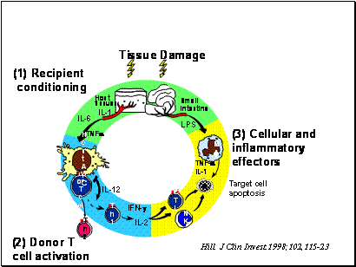
M3-B
Early Side-effects of Lymphoma Rx
“Cytokine storm” leading to GvHD:
Adopted from: Stonehouse-Lee 2007; www.oncolink.org

Slide 27
M3-B
Late Side-effects of Lymphoma Rx
All Chemotherapy:
  Impaired quality of life
  Increased risk of secondary cancers
  Transfusion-associated complications
  Cardiovascular: heart failure
  Hormonal: premature menopause, infertility
  Liver problems
  Lung disease, reduced lung capacity
  Osteoporosis
  Cataracts
Source: www.mayoclinic.org

Slide 28
M3-B
Late Side-effects of Lymphoma Rx
Chemotherapy-specific Late Side-effects:
Late Side Effect | Agents
Cardiac dysfunction | Doxorubicin, Mitoxantrone, Cyclophosphamide
Gonadal dysfunction (infertility, premature menopause) | Cisplatin, Cyclophosphamide, Cytarabine, Dacarbazine, Ifosfamide, Procarbazine
Renal/bladder dysfunction | Cisplatin, Cyclophosphamide, Ifosfamide, Methotrexate
Secondary leukemia | Cyclophosphamide, Dacarbazine, Etoposide, Ifosfamide, Procarbazine
Respiratory dysfunction | Bleomycin, Carmustine
Peripheral neuropathy | Cisplatin, Oxaliplatin, Thalidomide, Vincristine Bortezomib
Neuropsychological | Cytarabine, Methotrexate
None known | Fludarabine, Vinblastine
Source: www.cclg.org.uk

Slide 29
M3-B
Late Side-effects of Lymphoma Rx
Immunotherapy (MAbs):
  Potential long-term side-effects include progressive multifocal leukoencephalopathy (PML)
  No other long-term side-effects known

Slide 30
M3-B
Late Side-effects of Lymphoma Rx
Radiotherapy:
  Secondary cancers (breast, thyroid, lung)
  Dry mouth, cavities and tooth decay
  Heart and lung disease
  Endocrine: hypothyroidism, infertility
  Intestinal problems
  Hair loss
  Infections
  Cataracts
  Memory problems
  Osteoporosis
Source: www.mayoclinic.org

Slide 31
M3-B
Late Side-effects of Lymphoma Rx
Radiotherapy Site-specific Late Side Effects
RXT Site | Potential Late Side Effect
Neck (including spinal) | Thyroid dysfunction, nodules, malignancy, salivary hypofunction / xerostomia
Thoracic (including spinal) | Heart failure, respiratory dysfunction, breast hypoplasia or neoplasm
Abdominal | GI dysfunction, diarrhoea, GI fibrosis / stricture Hepatic dysfunction / fibrosis / cirrhosis Renal hypoplasia, glomerular dysfunction, proteinuria
Pelvic | Adverse pregnancy outcome, uterine hypoplasia / fibrosis Bladder fibrosis, haemorrhagic cystitis, avascular necrosis, impaired fertility
Skin / Soft tissue | Pigmented skin lesions, hypoplasia, fibrosis, atrophy
Source: www.cclg.org.uk

Slide 32
M3-B
Late Side-effects of Lymphoma Rx
Radioimmunotherapy:
  General (chills, fever, allergic reaction, urticaria, cough, dizziness, anxiety, dyspnoea, infection, throat irritation, joint pain)
  Gastrointestinal (nausea / vomiting, abdominal pain, diarrhoea)
  Haematological (neutropenia, thrombocytopenia, anaemia)
Source: www.mayoclinic.org

Slide 33
M3-B
Late Side-effects of Lymphoma Rx
Transplantation:
  Infections (cytomegalovirus, pneumocystis jiroveci pneumonia)
  Chronic GvHD
  Infertility
  Secondary malignancies
  Relapse of lymphoma
  Autoimmune disorders
  Hypothyroidism
  Psychological disturbance
Source: Brown, 2010

Slide 34
Module 3C:
Managing the Side-effects of Lymphoma Treatment

Slide 35
M3-C
Managing the Side-Effects
Managing Nausea and Vomiting
Management options
Radiotherapy:
  Antiemetic prophylaxis:
    A 5-HT3 receptor antagonist + dexamethasone
    Rescue: dopamine receptor antagonist or a 5-HT3 receptor antagonist
Chemotherapy:
  Three-drug regimen:
    A 5-HT3 receptor antagonist (ondansetron, dolasetron, granisetron, or tropisetron; given IV or PO) +
    Dexamethasone +
    A NK1 receptor antagonist (Aprepitant) given before chemotherapy
Note: Antiemetics most effective when given prophylactically
Source: Roila et al., 2010

Slide 36

M3-C
Managing the Side-Effects
Managing Nausea and Vomiting
Practical tips for patients
Take your anti-nausea medication regularly, even on days when you feel well
Drink plenty of fluids before, during and after therapy
Learn the best time for you to eat and drink / adapt meals and drinks according to symptoms
Eat 5 – 6 small meals/snacks instead of 3 big ones
Eat less spicy, greasy, fried, salty, or sweet foods
Eat food that is easy on your stomach
  clear soup, baked/broiled chicken, cream of wheat, oatmeal, white rice, banana, applesauce, yogurt, etc.
Consider complementary therapy (e.g. relaxation techniques, acupuncture, aromatherapy)
Source: www.cancer.gov

Slide 37
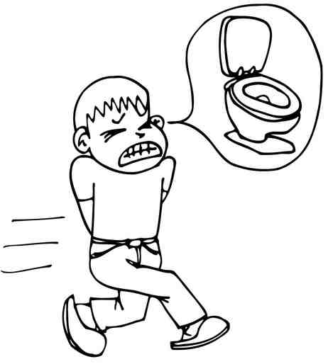
M3-C
Managing the Side-Effects
Managing Diarrhoea
Management options
Monitor for symptoms and signs of dehydration
  Thirst, dry mouth/mucosal membranes, reduced urine output, irritability
Electrolyte replacement
Over-the-counter anti-diarrhoeal drugs
Practical tips for patients
Avoid greasy, spicy, or fried foods
Avoid milk and dairy products
Eat simple, easy-to-digest foods:
  bananas, rice, applesauce, toast (called the BRAT diet)
Drink plenty of clear liquids
  Sports drinks, electrolyte-infused water
Talk to your doctor, nurse or dietician about other ways you can manage diarrhoea
Source: www.chemotherapy.com

Slide 38
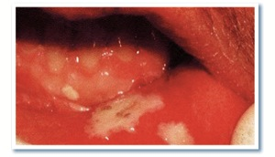
M3-C
Managing the Side-Effects
Managing Sore Throat / Mouth
Management options
Monitor for signs of infection
  Pink or red bleeding lesions
  Dry mucosa or tongue
  Painful, white patches or sores
Adequate pain management
  PCA with morphine for patients undergoing HSCT
Practical tips for patients
Brush your teeth (and tongue) gently after every meal with a very soft toothbrush
Avoid mouthwashes containing alcohol
Rinse mouth with water often
Avoid irritating acidic or spicy foods
Drink plenty of fluids
Suck on ice chips
Leave dentures out as much as possible
Report any change in taste/smell
Source: Peterson et al., 2011; www.cancer.gov ; www.clinicaloncology.com

Slide 39

M3-C
Managing the Side-Effects
Managing Hair Loss
Management options
Refer to hospital wig services or wig supplier experienced in fitting cancer patients
Refer to a patient support group
Practical tips for patients
Cut your hair very short before treatment starts; this will make it easier to deal with when it starts falling out.
Visit a wig supplier before all hair is lost to ensure a match in colour, texture and style
Use hats, hair bands, scarves
Use soft brushes and mild shampoos
Talk with others who have lost their hair during treatment
Source: www.cancer.gov; www.fairview.org

Slide 40


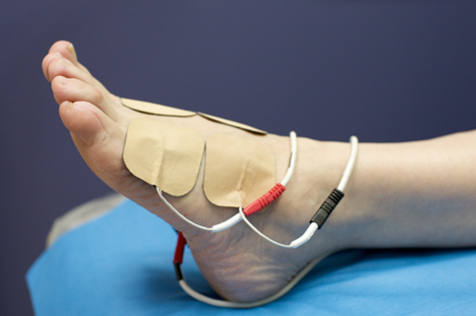
M3-C
Managing the Side-Effects
Managing Peripheral Neuropathy
Management options
Analgesics
Acupuncture can relieve pain
Massage can increase blood flow and provide pain relief
Exercise may help
Transcutaneous nerve stimulation (TENS)
Source: www.cancer.gov

Slide 41
M3-C
Managing the Side-Effects
Managing Peripheral Neuropathy
Practical tips for patients
Report to your doctor and nurse if you experience any of the following symptoms:
  numbness and tingling in your fingers, toes, hands or feet, stabbing pain, burning, muscle weakness, inability to feel pressure or sense hot or cold temperatures, shaking, trouble keeping your balance
Wear shoes inside and outside, and gloves
Move rugs out of your path so you won’t trip
Put up rails on the walls and in the bathroom, as needed
Ask someone to check the temperature e.g. before taking a bath
Check your hand and feet for cuts regularly.
Source: www.cancer.gov

Slide 42
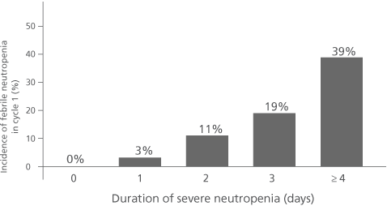
M3-C
Managing the Side-Effects
Managing Neutropenia and Infection
Management options
Monitor for signs of infection
Educate about contacting the healthcare team if symptoms of infection develop
G-CSF therapy (filgrastim, pegfilgrastim)
Prophylactic antibiotics
Note: A longer duration of severe neutropenia (ANC <0.5 x 10⁹/L) is directly related to an increased risk of febrile neutropenia (FN)
Note: ANC <1x10⁹/L greatly increases risk of infection and requires treatment
Source: de Naurois et al., 2010; Meza et al., 2002

Slide 43
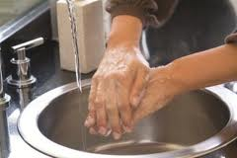
M3-C
Managing the Side-Effects
Managing Neutropenia and Infection
Practical tips for patients
Pay particular attention to personal hygiene e.g. hand washing, regular bathing
Avoid crowds (public transport, cinemas, etc.) and swimming in public pools / jacuzzi
Avoid people who may have an infection (cold, flu, etc.)
Take extra care of your skin (mild lotions, moisturizers)
Avoid bruising, cuts or tears of skin or nails
Keep a thermometer at home to check your temperature
Eat healthy, freshly cooked food
Avoid vaccines unless recommended by your doctor
Ask your nurse whether you should be on a ‘neutropenic diet’
Avoid foods that contain lots of live bacteria:
  soft cheeses, undercooked eggs / meat / fish, paté, peppercorns
Source: www.lymphomas.org.uk

Slide 44
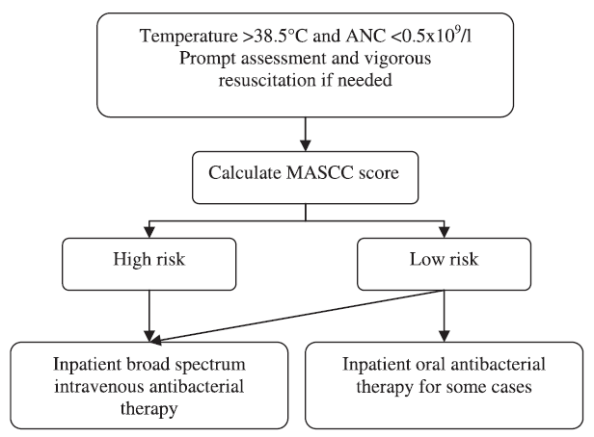
M3-C
Managing the Side-Effects
Managing Febrile Neutropenia
Definition and risks of FN:
Oral temperature >38.5ºC or two consecutive readings of >38.0ºC for 2 h and an ANC <0.5 x 10⁹/L, or expected to fall below 0.5 x 10⁹/L
Major dose-limiting toxicity
Mortality rate as high as 36% if the Multinational Association for Supportive Care (MASCC) score is <15
Management algorithm
Source: de Naurois et al., 2010

Slide 45
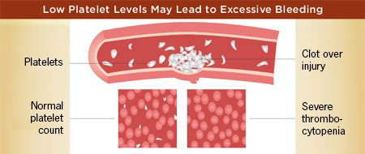
M3-C
Managing the Side-Effects
Managing Thrombocytopenia
Management options
Platelet transfusions
Practical tips for patients
Avoid cuts, bruises and falls
Be careful when:
  Using scissors, needles, knives or other sharp tools
  Shaving (→ Use an electric razor)
  Cleaning teeth (→ Use a very soft toothbrush)
  Blowing your nose
If you bleed, apply pressure for about 10 minutes and a bandage, if appropriate
Note: There is a severe risk of bleeding if platelet count is below 10−20x10⁹/L
Source: www.cancercouncil.com; www.chemotherapy.com

Slide 46
M3-C
Managing the Side-Effects
Managing monoclonal antibody (Rituximab) Infusion-related Side-effects
Management options
Prophylactic:
  Antipyretic
  Antihistamine
Those at risk of tumour-lysis syndrome:
  Allopurinol
Decrease rate of infusion
Withhold antihypertensive medications (12 hours before and during infusion)

Slide 47
M3-C
Managing the Side-Effects
Managing radiotherapy-induced skin problems
Management options
Assess skin integrity before and after treatment
Assess dehydration before and after treatment
Practical tips for patients
Maintain good skin condition
  Avoid soap in area of radiation
  Keep dry but moisturised (using only prescribed creams)
  Avoid exposure to the sun
Leave irritated areas open to the air when possible
Use only creams prescribed by radiotherapy department on blistered areas
Wear loose, breathable fabrics and avoid tight straps (belts, underwear)
Drink plenty of fluids

Slide 48
M3-C
Managing the Side-Effects
Managing Post-transplant Side-effects
Management options
Carry out baseline assessments
Administer conditioning therapy
Administer stem cells / bone marrow
Assess patient regularly
Monitor blood counts
Provide mouth care
Administer prophylactic
treatment for infection and GvHD
Monitor and treat infection
Monitor organ toxicity
Support nutrition
Address patient concerns
Practical tips for patients
Ask team for advice
Wash hands before and after handling food
Shower daily, change clothes and bed linen regularly
Avoid unnecessary personnel and people who are ill
Get advice on foods
Perform gentle exercise

Slide 49
Module 3D:
Drug interactions
with oral therapies

Slide 50
M3-D
Drug Interactions with Oral Therapies
Many drugs and herbal preparations interact extensively with drug metabolizing enzymes in the liver
20–30% of all adverse drug reactions are caused by drug-drug interactions (DDIs)
Categories on drug interactions:
  Pharmaceutical (physical, chemical)
  Pharmacokinetic (PK; altered absorption, metabolism, elimination)
  Pharmacodynamic (PD; additive, synergistic, antagonistic effect)
Clinically important interactions have been detected with several chemotherapy agents
Recognizing interactions between the different medications is essential for prompt management
Source: Köhler et al., 2000; van Leeuwen et al., 2011;

Slide 51
M3-D
Drug Interactions with Oral Therapies
Examples of DDIs with chemotherapy
Chemotherapy | Interacting Drug | Adverse Outcome
Bleomycin | Cisplatin | ↑ Bleomycin → Pulmonary toxicity
Bleomycin | Lomustine, teniposide | ↑ Myelosuppression
Carboplatin | Aminoglycosides | ↑ Hearing loss
Cisplatin | Diazoxide, Aminoglycoside antibiotics | ↑ Nephrotoxicity
Cyclophosphamide | Azathioprine | Hepatotoxicity, hepatic necrosis
Cyclophosphamide | Cytarabine | Cardiotoxicity
Cyclophosphamide | Warfarin | Coagulation changes
Dacarbazine | Naltrexone | ↑ Hepatotoxicity
Doxorubicin | Cyclosporin | Coma, seizures
Doxorubicin | Streptozocin | ↑ Myelosuppression, mucositis
Doxorubicin | TCAs | QT prolongation, torsade de pointes
Source: King 2001; Katayama et al., 2009; Chan et al., 2012

Slide 52
M3-D
Drug Interactions with Oral Therapies
Examples of DDIs with chemotherapy (cont’d)
Chemotherapy | Interacting Drug | Adverse Outcome
Etoposide | Cyclosporine | ↑Etoposide → ↑Myelosuppression
Fluorouracil | Leukovorin | ↑ GI toxicity (mucositis, diarrhoea)
Fluorouracil | Metronidazole | ↑ Fluorouracil → ↑ granulocytopenia
Fluorouracil | Warfarin | ↑ Prothrombin time
Methotrexate | Amiodarone | Skin necrosis
Methotrexate | Ciprofloxacin | Mucositis, necrotic skin lesions, febrile pancitopenia
Methotrexate | Co-trimoxazole | Severe pancitopenia
Methotrexate | Ethanol | ↑ Hepatotoxicity
Methotrexate | NSAIDs | Severe myelosuppression, mucositis
Methotrexate | Probenecid | ↑ Myelosuppression, mucositis
Methotrexate | PPIs (e.g. omeprazole) | Severe mucositis, renal failure
Source: King 2001; Bauters et al., 2008; Hanigan 2009; Ranchon et al., 2011 ; Jarfaut et al., 2013

Slide 53
M3-D
Drug Interactions with Oral Therapies
Examples of DDIs with chemotherapy (cont’d)
Chemotherapy | Interacting Drug | Adverse Outcome
Ifosfamide | Phenobarbital | Neurotoxicity, coma
Procarbazine | Antidepressants (TCA, SSRI, SNRI) | ↑ Risk of CNS toxicity or serotonin syndrome
Procarbazine | Selegiline | ↑ Risk of hypertensive crisis
Procarbazine | Ethanol | Flushing, headache, nausea, ↓BP
Procarbazine | Sympathomimetics | Risk of extreme hypertension
Vinblastine | Mitomycin | Abrupt pulmonary toxicity
Vinblastine | Interferon alpha | ↑ Risk of peripheral neuropathy
Vincristine | Itraconazole | ↑ Neurotoxicity
Vincristine | Posaconazole | ↑ Neurotoxicity
CHOP | HAART | Severe autonomic neurotoxicity
Source: King 2001; Jeng and Feusner, 2001; Vaccher et al., 2001; Eiden et al., 2009; Jain and Kapoor 2010; Chan et al., 2012; Moriyama et al., 2012; Foroughinia et al., 2012

Slide 54
Module 3E:
Other Treatment Considerations

Slide 55
M3-E
Other Treatment Considerations
Recognizing the importance of adhering to the prescribed treatment regimen
  High treatment compliance is associated with better outcomes, including survival
  Side effects are the main cause of non-compliance
  Non-compliance higher amongst adolescents
  Adherence promotion interventions
    Special educational and supportive programs designed to improve patient compliance are associated with significant prolongation of patient survival
    Might be tailored to subgroups of patients who demonstrated problematic patterns of treatment adherence
Source: Richardson et al., 1990; Kondryn et al., 2011

Slide 56
M3-E
Other Treatment Considerations
Complementary and alternative therapies
Complementary therapies
Used along with regular lymphoma care
Do not offer cure, but may ease the symptoms
Examples:
  meditation to reduce stress
  acupuncture to relieve pain
  peppermint tea to relieve nausea
Note: Some complementary therapies may not have been tested and some may even be harmful!
Alternative therapies
Used instead of regular lymphoma care
May be (falsely) promoted as treatments offering cure and having very few or no side effects
Most of these therapies have not been tested in clinical trials
Choosing alternative therapy over standard treatment may lead to disease progression with reduced chance of cure or improvement
Source: www.cancer.org

Slide 57
Module 3F:
Long-term Follow-up

Slide 58
M3-F
Long-term Follow-up
Follow-up Schedule and Duration
  Patients are monitored by the medical team regularly after treatment, including:
  The follow-up schedule and duration is individualized based on:
    Lymphoma type, stage and type of treatment received
    The patient’s overall health
    Local practices (country, institution)
  Key purpose: to check for recurrence (the return of cancer in the primary site) or metastasis (the spread of cancer to another part of the body) and late side effects (including secondary cancer).
  Frequency: usually every 3 to 4 months during the first 2 to 3 years after treatment, and once or twice a year after that
  Importance of adhering to the schedule
Source: www.cancer.gov

Slide 59

M3-F
Long-term Follow-up
Follow-up Assessments
Questioning the patient, review of symptoms
Physical examination
Investigative techniques (imaging, laboratory)
Tumour assessments
  Response assessed according to standard criteria
  Response categories:
    Complete response (CR), partial response (PR)
    No response / stable disease (SD)
    Progressive disease (PD)
Source: www.cancer.gov

Slide 60
M3-F
Long-term Follow-up
Restaging
  The initial clinical staging of NHL may be altered following pathological staging investigations
  Re-assessment is often carried out after treatment, leading to restaging of disease
  Monitoring disease stage is important to ensure appropriate treatment
Source: www.cancer.gov

Slide 61
M3-F
Long-term Follow-up
Safety monitoring
    Long-term complications
      transformation to high grade lymphoma
      secondary cancer
    Long-term side effects of lymphoma treatment

Slide 62
Module 3
References
Bauters TG, Verlooy J, Robays H, et al. Pharm World Sci. 2008 Aug;30(4):316-8.
Cancer Council. Chemotherapy: tips for managing side effects. Accessed at: http://www.cancercouncil.com.au
Chan A, Ng TR, Yap KY. Expert Opin Drug Metab Toxicol. 2012 Feb;8(2):173-99. Costantini M, Ripamonti C, Beccaro M et al. Ann Oncol 2009; 20: 729–735.
Eiden C, Palenzuela G, Hillaire-Buys D, et al. J Pediatr Hematol Oncol. 2009 Apr;31(4):292-5.
Foroughinia F, Baniasadi S, Seifi S, et al. Curr Drug Saf. 2012 Nov 1;7(5):372-4.
Hanigan MH. Expert Opin Drug Metab Toxicol. 2009 Feb;5(2):105-7.
Jain S, Kapoor G. Pediatr Blood Cancer. 2010 May;54(5):783.
Jarfaut A, Santucci R, Levêque D, et al. Med Mal Infect. 2013 Jan;43(1):39-41.
Jeng MR, Feusner J. Pediatr Hematol Oncol. 2001 Mar;18(2):137-42.
Kamaluddin M, McNally P, Breatnach F, et al. Acta Paediatr. 2001 Oct;90(10):1204-7.
Katayama M, Imai Y, Hashimoto H, et al. J Cardiol. 2009 Oct;54(2):330-4.
King RS. Drug Interactions in the Cancer Chemotherapy Patient. In: Cancer Chemotherapy: A Nursing Process Approach; 2001. ISBN 0-7637-1472-0
Köhler GI, Bode-Böger SM, Busse R, et al. Int J Clin Pharmacol Ther. 2000 Nov;38(11):504-13.

Slide 63
Module 3
References
Kondryn HJ, Edmondson CL, Hill J, et al. Lancet Oncol 2011;12:100–08.
Lymphoma Association (UK). Neutropenia – A guide for people with lymphoma. Accessed at: http://www.lymphomas.org.uk
Meza L, et al. Proc Am Soc Clin Oncol. 2002;21:Abstract 2840.
Moriyama B, Henning SA, Leung J, et al. Mycoses. 2012 Jul;55(4):290-7.
National Cancer Institute: Managing Chemotherapy Side Effects – Nausea and Vomiting. Accessed at: http://www.cancer.gov
National Cancer Institute: Managing Chemotherapy Side Effects – Nerve Changes. Accessed at: http://www.cancer.gov
National Cancer Institute: Managing Radiation Therapy Side Effects – What To Do About Hair Loss (Alopecia). Accessed at: http://www.cancer.gov
Nishimura N, Nakano K, Ueda K, et al. Support Care Cancer. 2012 Sep;20(9):2053-9. Ranchon F, Vantard N, Gouraud A, et al. Chemotherapy. 2011;57(3):225-9.
Richardson JL, Shelton DR, Krailo M, et al. J Clin Oncol. 1990 Feb;8(2):356-64.
Ripamonti CI, Santini D, Maranzano E, et al. Management of cancer pain: ESMO Clinical Practice Guidelines. Ann Oncol. 2012 Oct;23 Suppl 7:vii139-54.
Roila F, Herrstedt J, Aapro M, et al. [ESMO] Ann Oncol. 2010 May;21 Suppl 5:v232-43. Vaccher E, Spina M, di Gennaro G, et al. Cancer. 2001 Jan 1;91(1):155-63.

Slide 64
M3
Questions & Answers
  Questions from Training Participants?

