Slide 1
Lymphoma Learning Programme
for Nurses and
Allied Healthcare Professionals
September/2014

Slide 2
Module 2:
Lymphoma Treatments

Slide 3
Module 2 Objectives
After completing this module, participants should be able to:
  Explain how lymphoma is treated at different disease stages
  Recognize the nurses’ role in lymphoma treatment and apply this knowledge to daily practice

Slide 4
Module 2 Overview
Lymphoma treatment
  The aims of lymphoma treatment
  Lymphoma treatment guidelines
  Types of lymphoma treatment
  Treatment options for individual lymphoma types
  Supportive treatment and care
  Treatment of special treatment groups
  The future of lymphoma treatment

Slide 5
Module 2 Overview
B. Nursing Implications & Nurse Interventions: Key role of nurses in managing lymphoma patients
  Patient support during radiotherapy and radioimmunotherapy
  Patient support during chemotherapy
  Patient support during immunotherapy and immunochemotherapy
  Patient support pre- and post-transplant
  Coping with uncertainty
  Supportive and palliative care

Slide 6
Module 2A:
Overview of Lymphoma Treatments

Slide 7
M2-A
The Aims of Lymphoma Treatment
Indolent lymphomas
  Watch-and-wait
  Prolongation of the disease-free period, minimising disease extent, preventing/alleviating symptoms
Aggressive lymphomas
  Aggressive treatment, to achieve complete (or partial) remission

Slide 8
M2-A
Lymphoma Treatment Guidelines
Local:
  Institutional
  Health Authority
  National
International

Slide 9
M2-A
Lymphoma Treatment Guidelines
European Society for Medical Oncology (ESMO) clinical practice guidelines for haematological malignancies:
  Hodgkin lymphoma (Eichenauer et al., 2011)
  Diffuse large B-cell lymphoma (DLBCL) (Tilly et al., 2012)
  Follicular lymphoma (Dreyling et al., 2011)
  Marginal zone B-cell lymphoma of the mucosa-associated lymphoid tissue (MALT)-type (Zucca et al., 2013)
  Chronic lymphocytic leukemia (CLL) (Eichhorst et al., 2011)
  Primary cutaneous lymphomas (Willemze et al., 2010)
  Waldenström's macroglobulinaemia (Buske et al., 2013)

Slide 10
M2-A
Lymphoma Treatment Guidelines
Evidence-based ‘best practice’ standard of care guidelines are only available from:
  The National Comprehensive Cancer Network (NCCN) in the U.S.A
  The National Cancer Institute (NCI) of the National Institutes of Health (NIH) in the U.S.A.
  The BC Cancer Agency in Canada
  The German Hodgkin Study Group
Other guidelines are not lymphoma-specific and mostly provide general treatment information
Source: Lymphoma Coalition, Standard of Care by Country. 2012

Slide 11
M2-A
Types of Lymphoma Treatment (1)
The choice of treatment mainly depends on the:
  Type of lymphoma
    Hodgkin Lymphoma, NHL subtype
  Disease stage (Ann Arbor classification) and location
  How quickly the cancer is growing
    Indolent or aggressive lymphoma
  Patient age
  Age-adjusted International Prognostic Index (aaIPI) risk level
  Feasibility of dose-intensified approaches
  Eligibility for stem cell transplant (SCT)
  Presence of other health problems

Slide 12
M2-A
Types of Lymphoma Treatment (2)
Treatment option | Description | Specific target
‘Watch and wait’ | Close monitoring for signs and symptoms of disease progression | n/a
Radiotherapy | High-energy rays that kill or slow down growth of lymphoma cells | 
Chemotherapy | Drugs that kill rapidly dividing cells, including lymphoma cells | 
Monoclonal antibody | Agent designed to target and destroy lymphoma cells | 
SCT | Infusion of healthy stem cells helps the body restore its supply of healthy blood cells | 
Interferon | Therapy which activates the immune system to attack lymphoma cells | 

Slide 13


M2-A
Types of Lymphoma Treatment (3)
Lymphoma treatments: “Watch and wait”
  Not appropriate for aggressive NHL which requires immediate treatment
  In indolent NHL, a study¹ has shown no difference in overall survival similar in patients receiving:
    Immediate chemotherapy (chlorambucil)
    No initial treatment
  Many patients with indolent NHL do not require active treatment immediately
  Patients closely monitored
  Treatment initiated when disease progresses
1. Stien RS and Greer JP. 2003

Slide 14
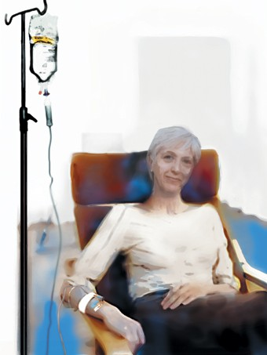
M2-A
Types of Lymphoma Treatment (4)
Lymphoma treatments: Chemotherapy
  Commonly used treatment for NHL
  May be given as single agent or combination
  Treatment is tailored to patient’s individual needs
  Single agent chemotherapy
    Common chemotherapy agents:
      Alkylating agents (cyclophosphamide, chlorambucil)
      Purine nucleoside analogues (fludarabine, 2-chlorodeoxyadenosine)
      Bendamustine
      Cyclophosphamide (Cytoxan)
      Chlorambucil
  Combination chemotherapy
    Often associated with more side-effects

Slide 15
M2-A
Types of Lymphoma Treatment (5)
Commonly used combination regimens for NHLs:
CHOP | cyclophosphamide, doxorubicin, oncovin/vincristine, prednisone
CHOEP/EPOCH | cyclophosphamide, doxorubicin, oncovin/vincristine, prednisone plus etoposide
CVP | cyclophosphamide, vincristine, prednisone)
FC | fludarabine+cyclophosphamide
COMLA | cyclophosphamide, vincristine, methotrexate with leucovorin rescue, cytarabine
BACOP | bleomycin, doxorubicin, cyclophosphamide, vincristine, prednisone
APO | doxorubicin, vincristine, prednisone, methotrexate, 6-mercaptopurine
ProMACE-CytaBOM | cyclophosphamide, etoposide, doxorubicin, prednisone, cytarabine, bleomycin, vincristine, intermediate-dose methotrexate
M-BACOD | intermediate-dose methotrexate, bleomycin, doxorubicin, cyclophosphamide, vincristine, dexamethasone
MACOP-B | methotrexate with leucovorin rescue, doxorubicin, cytoxan, vincristine, prednisone, bleomycin
Other | L10 or L17 protocols used for adult lymphocytic leukemia

Slide 16

M2-A
Types of Lymphoma Treatment (6)
Lymphoma treatments: Immunotherapy
  Single agent immunotherapy
    Rituximab
    Other monoclonal antibodies (MAb)
  Immunochemotherapy without anthracyclines
    R-bendamustine, R-FC, R-CVP, R-GemOx, R-chlorambucil
  Immunochemotherapy with anthracyclines
    R-FCM, R-CHOP, R-MCP
  Intensive immunochemotherapy regimens
    R-ICE, R-EPOCH, R-HyperCVAD, R-DHAP
  Radioimmunotherapy

Slide 17
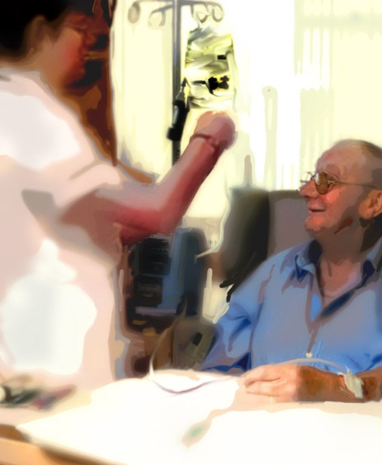
M2-A
Types of Lymphoma Treatment (7)
Lymphoma treatments: Other Targeted Therapy
  Antibody-drug conjugates
    brentuximab vedotin
  Molecular target agents
    Proteasome inhibitors (bortezomib, ixazomib)
    Immunomodulatory drugs (IMiDs; lenalidomide)
    HDAC inhibitors (vorinostat, romidepsin)
    mTOR inhibitors (temsirolimus/CC-779, everolimus/RAD001)
    Aurora A kinase inhibitors (alisertib)

Slide 18
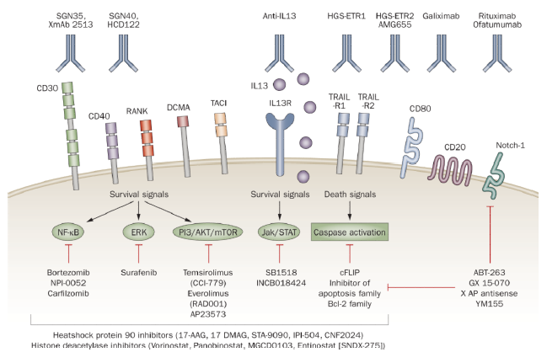
M2-A
Types of Lymphoma Treatment (8)
Targeted therapy
Source: Younes A , 2011
Notes:
Targeted therapy for lymphoma treatment. Cancer cells express a variety of receptors and antigens that can be targeted by monoclonal antibodies. Many of these receptors trigger well-defined signaling pathways that promote the growth and survival of lymphoma cells, including NF-κB, ERK, PI3K/Akt/mTOR JAK/STAT, and extrinsic and/or intrinsic apoptosis pathways. These signaling pathways can be targeted by a variety of smallmolecule inhibitors. Abbreviations: ERK, extracellular signal-regulated kinase; JAK/STAT, janus kinase/signal transducer and activator of transcription; NF-κB, nuclear factor-kappa-B; RANK, receptor activator for NF-κB; TRAIL-R1, tumor necrosis factor–related apoptosisi nducing ligand death receptor R1. Reproduced from Hematology by Anas Younes. Copyright 2009 by American Society of Hematology (ASH). Reproduced with permission of American Society of Hematology (ASH) in the format Journal via Copyright Clearance Center.

Slide 19
M2-A
Types of Lymphoma Treatment (9)
Monoclonal Antibodies (MAb)
  What do the suffixes indicate?
    The amount of murine component in the monoclonal antibody
      -momab = murine (pure mouse) drug
      -ximab = mostly human partly mouse (chimeric)
      -zumab = humanized and only a small part mouse
      -umab = fully human antibodies

Slide 20
M2-A
Types of Lymphoma Treatment (10)
Types of Monoclonal Antibodies
Unconjugated / naked MAbs:
Rituximab
Alemtuzumab
Ofatumumab
GA101
Veltuzumab
AME 133v
PRO 131921
Conjugated MAbs:
Radio-immuno- conjugates:
Ibritumomab tiuxetan Tositumomab
Drug conjugates:
Brentuximab Vedotin (SGN35)
Inotuzumab ozogamicin (CMC-544)
SAR3419 maytansinoid derivative DM4
Bispecific:
Blindatumomab (T-cell engager )
Source: Shankland KR et al. 2012.

Slide 21
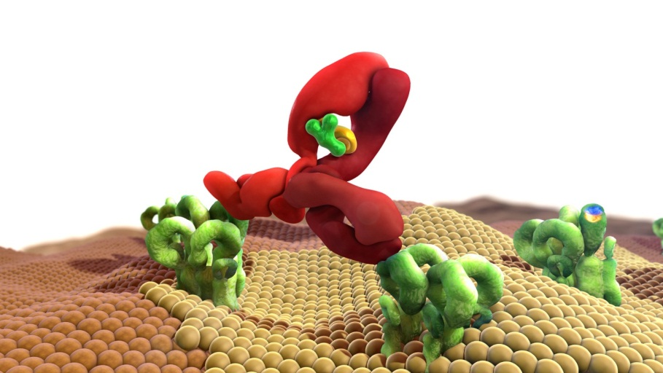
M2-A
Types of Lymphoma Treatment (11)
Monoclonal Antibodies: Rituximab
  Genetically engineered, chimeric (murine-human) monoclonal antibody specifically directed against the B-cell surface protein CD20
  Since CD20 is only present in B-cells, but absent in hematopoietic stem cells, dendritic cells and plasma cells, complete regeneration of healthy B-lymphocytes from hematopoietic stem cells is possible after the treatment with Rituximab

Slide 22
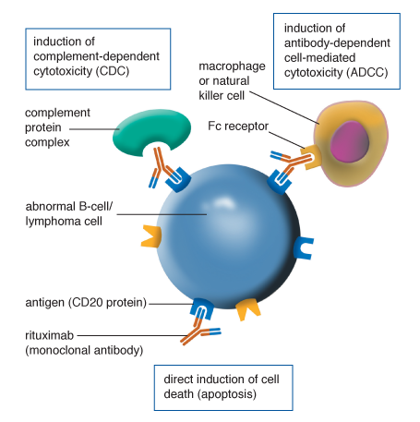
M2-A
Types of Lymphoma Treatment (12)
Monoclonal Antibodies: How do they work?
Rituximab:
  Targeted mode of action
  Binds to CD20 on lymphoma cell surface
    Triggers immune response to act against lymphoma cells
  or
    Kills targeted cells directly
    May also increase susceptibility to chemotherapy

Slide 23
M2-A
Types of Lymphoma Treatment (13)
Rituximab: How is it administered?
Given IV, as monotherapy or combined with chemotherapy (immunochemotherapy, ICT)
Dosage: 375 mg/m² of body surface area (700 mg per infusion for an averaged sized person)
Duration of the infusion: 4-5 hours (first infusion), 90 minutes (second and subsequent infusions)
Note: Rapid B-cell death upon Rituximab administration can cause tumor-lysis syndrome (TLS), a potentially life-threatening condition.
Therefore patients need to be well hydrated and closely monitored
for several hours after the first infusion.

Slide 24
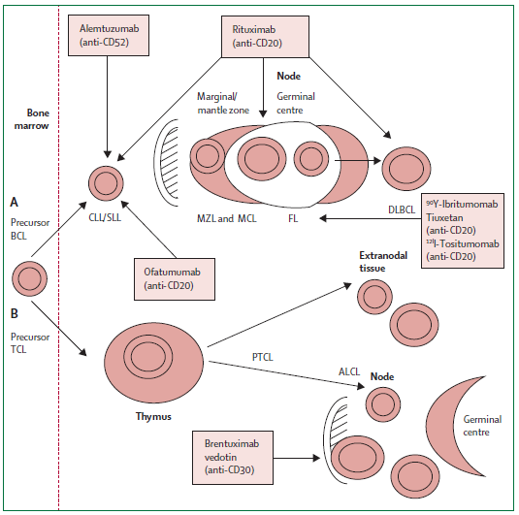
M2-A
Types of Lymphoma Treatment (14)
Monoclonal Antibodies
Source: Shankland KR et al. 2012.

Slide 25
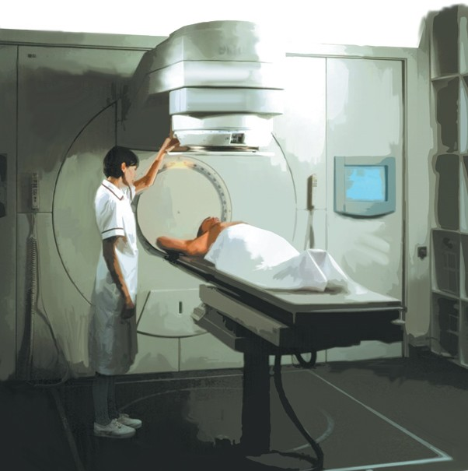
M2-A
Types of Lymphoma Treatment (15)
Lymphoma treatments: Radiotherapy
  High-energy rays damage and destroy lymphoma cells
  Typical treatment course: 2–6 weeks
  Complete regression of lymphadenopathy can be achieved in patients with localised follicular lymphoma
  Symptoms caused by organ enlargement
  can be reduced or alleviated
  May be used in combination
  with chemotherapy

Slide 26
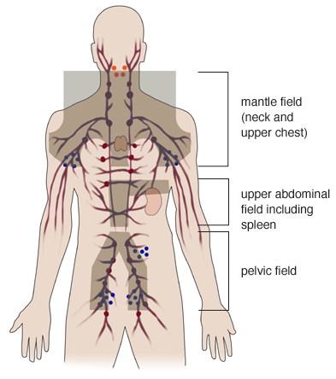
M2-A
Types of Lymphoma Treatment (16)
Lymphoma treatments: Radiotherapy (cont’d)
  Radiation is directed at a specific area of the body
  Common fields of radiation:
    Mantle
    Upper abdominal
    Pelvic

Slide 27
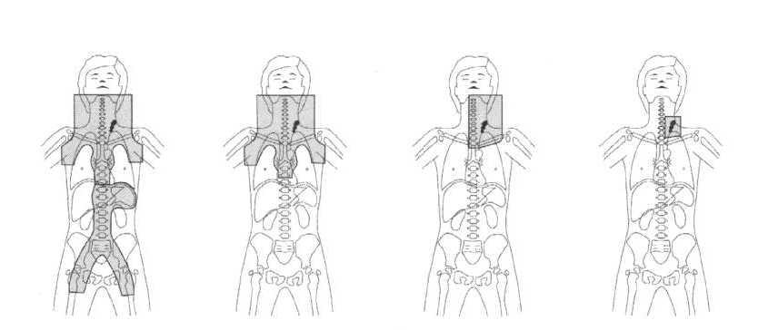
M2-A
Types of Lymphoma Treatment (17)
Evolution of Radiotherapy over the past 40 years
FIELDS:
Total Nodal RT
Extended Field RT
Involved Field RT
Involved Site RT
DOSE:
30 – 45 Gy
30 – 45 Gy
Source: Engert et al., 2005; Engert et al., 2010; Eich 2010; Campbell et al., 2008; Gilson D (slideset)

Slide 28
M2-A
Types of Lymphoma Treatment (18)
Lymphoma treatments: Radioimmunotherapy
  Administration of a systemically delivered and specifically targeted antibody labelled with cytotoxic radioactivity
  Radiation is delivered from within the body to the lymphoma cells
    Radiation delivered from within the body to the lymphoma cells
    The antibody targets the B-cells (lymphoma cells) and the radioactive molecules destroy them
  Requires specially trained clinical staff to prepare and administer
  Patients with more than 5% lymphoma bone marrow involvement or bone marrow-reserve impairment are not eligible for this type of treatment.

Slide 29
M2-A
Types of Lymphoma Treatment (19)
Lymphoma treatments: Stem cell transplant (SCT)
  Usually reserved for patients with relapsed NHL
  High-dose chemotherapy with or without radiation to deplete all cells from bone marrow
  Stem cells collected (“harvested”) either from the bone marrow or peripheral blood stem cell (PBSC) collection (using apheresis, or cell separator)
  Two main types of SCT, depending on the source of stem cells:
    Autologous (stem cells taken from patient) or
    Allogeneic (stem cells taken from a donor)
  Infusion of stem cells allows bone marrow to recover from chemotherapy and supply new healthy blood cells

Slide 30
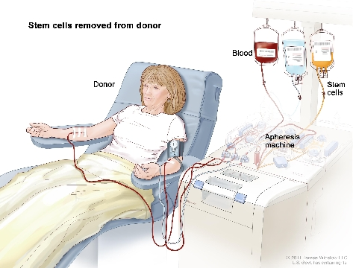
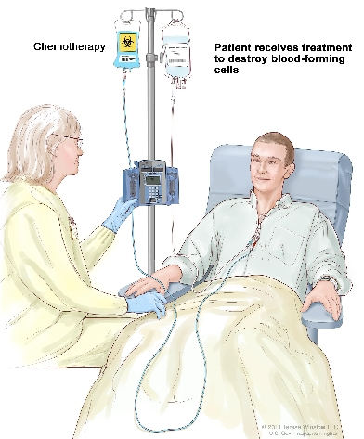
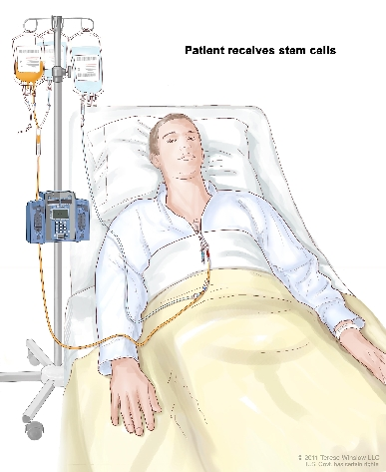
M2-A
Types of Lymphoma Treatment (20)
Haematopoietic Stem Cell Transplantation
Step 1: Blood is taken from a vein in the arm of the donor.
Step 2: The patient receives chemotherapy to kill blood-forming cells.
Step 3: The patient receives stem cells through a catheter placed into a blood vessel in the chest.
Source: http://www.umgcc.org/hem_malig_program

Slide 31
M2-A
Types of Lymphoma Treatment (21)
Palliative Treatment and Care
  Provides relief from pain and other distressing symptoms
  Enhances quality of life
  May also positively influence the course of illness
  Integrates the psychological and spiritual aspects of patient care
  Offers a support system to:
    Help patients live as actively as possible until death and
    Help the family cope during the patients illness
  Regards dying as a normal process and intends neither to hasten or postpone death; however, it offers a support system to help the family cope in their bereavement

Slide 32
M2-A
Lymphoma Treatment Options (1)
Treatment Options for NHLs: DLBCL
  Immediate treatment required (aggressive NHL type)
  First line treatment: CT plus rituximab ± RXT
    IPI low risk/no bulk: R-CHOP x 6 [standard]
    IPI low-intermediate risk or with bulk:
      R-ACVBP and sequential consolidation
      R-CHOP x 6-8 ± RXT
    IPI intermediate-high or high risk:
      R-CHOEP x 8
      R-CHOP x 8
      R-ACVBP and sequential consolidation
ASCT: autologous stem cell transplantation; CT: chemotherapy; HD: high dose; RXT: radiotherapy
R-CHOP: rituximab plus cyclophosphamide, doxorubicin, vincristine, and prednisone
R-CHOEP: R-CHOP + etoposide
R-ACVB: rituximab plus doxorubicin, vindesine, cyclophosphamide, bleomycin, and prednisolone

Slide 33
M2-A
Lymphoma Treatment Options (2)
Treatment Options for NHLs: DLBCL (cont’d)
  Relapsed / refractory DLBCL:
    1st Relapse:
      Platinum-based CT (R-DHAP, R-ICE, R-GDP) as salvage, followed by R-HDCT with ASCT as remission consolidation
      Clinical trial participation (novel drugs)
    ≥2 Relapse:
      Salvage chemotherapy
      Allogeneic SCT
      Clinical trial participation (novel drug)
      Palliative care

Slide 34
M2-A
Lymphoma Treatment Options (3)
Treatment Options for NHLs: FL
  First-line options for FL:
    “Watchful waiting” (asymptomatic cases)
    Radiation (can provide a cure in limited disease)
    Chemotherapy or rituximab (Rituxan), alone or in combination (advanced stages)
    Common combination regimens:
      R-CVP (rituximab, cyclophosphamide, vincristine, prednisone)
      R-CHOP (rituximab, cyclophosphamide, doxorubicin, vincristine, prednisone)
      R-Bendamustine
    Rituximab also as maintenance therapy
    Other MAbs (Ibritumomab tiuxetan [Zevalin], tositumomab [Bexxar]) also used in FL

Slide 35
M2-A
Lymphoma Treatment Options (4)
Treatment Options for NHLs: FL (cont’d)
  Relapsed/Refractory FL:
    Chemotherapy, radiation, and Mabs (ruximab, Rituxan) used alone or in combination
    Common second-line combination regimens :
      R-CHOP (rituximab, cyclophosphamide, doxorubicin, vincristine, prednisone)
      R-CVP (rituximab, cyclophosphamide, vincristine, prednisone)
      Bendamustine (Treanda) alone or with rituximab
    Radioimmunotherapy (RIT) used alone or in combination with chemotherapy:
      Iodine 131 tositumomab (Bexxar) and
      Y90 ibritumomab tiuxetan (Zevalin)
    Transformed lymphoma (develops in 30-40% of FL) is treated with high-dose chemotherapy and autologous SCT

Slide 36
M2-A
Lymphoma Treatment Options (5)
Treatment Options for NHLs:
MALT MZL
Gastric MALT MZL
Non-gastric MALT MZL
First-line Treatment:
Antibiotic therapy for 2 weeks
  Response rate: 70-90%
  Approximately 50% of patients require no further therapy
Second-line Treatment:
Bendamustine (Treanda) or Bortezomib (Velcade)
Chemotherapy
Radiation (low dose)
Rituximab (Rituxan)
Surgical excision
Radiation- or surgical therapy with/without chemotherapy

Slide 37
M2-A
Lymphoma Treatment Options (6)
Treatment Options for NHLs:
Other MZL
Nodal MZL
Splenic MZL
“Watchful waiting”
Radiation therapy and/or chemotherapy
Splenectomy
Low-dose radiation of the spleen (non-surgical candidates)
Rituximab with/without chemotherapy
  Common chemotherapy agents: purine analogs (fludarabine, cladribine) or alkylating agents (cyclophosphamide)

Slide 38
M2-A
Lymphoma Treatment Options (7)
Treatment Options for NHLs: CLL/SLL
  First line Treatment:
    “Watchful waiting”
    SCT (typically allogeneic)
      Patients with advanced disease, or with certain high risk features, or with transformed disease
    Rituximab (Rituxan) with chemotherapy
      BR (bendamustine, rituximab)
      FCR (fludarabine, cyclophosphamide, rituximab)
      FR (fludarabine, rituximab)
      PCR (pentostatin, cyclophosphamide, rituximab)
      R-CHOP (rituximab, cyclophosphamide, doxorubicin, vincristine, prednisone)

Slide 39
M2-A
Lymphoma Treatment Options (8)
Treatment Options for NHLs: CLL/SLL (cont’d)
  Relapsed/Refractory CLL/SLL:
    Single agent therapies
      Single agent MAb: Rituximab (Rituxan), Alemtuzumab (Campath), or Ofatumumab (Arzerra)
      Fludarabine (Fludara)
      Bendamustine (Treanda)
      Chlorambucil (Leukeran)
    Rituximab (Rituxan) with chemotherapy
      BR (bendamustine, rituximab)
      FCR (fludarabine, cyclophosphamide, rituximab)
      FR (fludarabine, rituximab)
      R-CHOP (rituximab, cyclophosphamide, doxorubicin, vincristine, prednisone)
      R-CVP (cyclophosphamide, vincristine, prednisone)

Slide 40
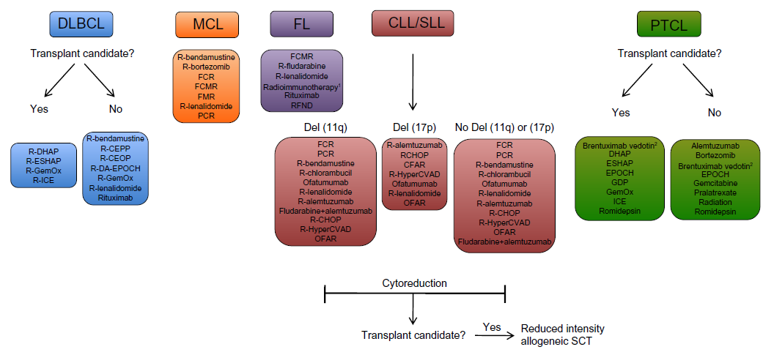
M2-A
Lymphoma Treatment Options (9)
Treatment of Relapsed/Refractory NHLs
Source: Chao MP. Cancer Manag Res. 2013 Aug 23;5:251-69.

Slide 41
M2-A
Lymphoma Treatment Options (10)
Treatment Options for Hodgkin lymphoma (classical)
  First line treatment:
    Chemotherapy (most patients), sometimes with radiation therapy
    Common combination regimens:
    ABVD (doxorubicin, bleomycin, vinblastine, dacarbazine) ± radiation therapy
    BEACOPP (bleomycin + etoposide + doxorubicin + cyclophosphamide + vincristine + procarbazine + prednisone), escalated depending on HL risk group and overall health status

Slide 42
M2-A
Lymphoma Treatment Options (11)
Treatment Options for Hodgkin lymphoma (classical)
  Relapsed / refractory HL:
    Salvage chemotherapy with DHAP, followed by HDT and autologous SCT
    Brentuximab vedotin (Adcetris)
      Approved in 2011 for use after SCT by the U.S. FDA
    Allogeneic TPL in second relapse
  Over 80% of patients with HL are cured.

Slide 43
M2-A
Supportive Treatment & Care (1)
Supportive treatment (medical)
  Erythropoietin
  Antiemetics
  Analgesics
  Steroids (anti-inflammatory and analgesic effect)
  Transfusions (as needed)
  G-CSF

Slide 44
M2-A
Supportive Treatment & Care (2)
Source: Ripamonti et al., 2012

Slide 45
M2-A
Supportive Treatment & Care (3)
Supportive care (non-medical)
  Advice and information
  Help with emotional, physical, practical, financial and social needs
  Symptom relief
  Spiritual support
  Contacts for care and support (e.g. support groups)

Slide 46
M2-A
Special Patient Groups (1)
Treatment of special patient groups:
  Paediatric patients
  Adolescents and young adults (AYA)
  Elderly patients
  Pregnant patients
  Transplant recipients

Slide 47
M2-A
Special Patient Groups (2)
Paediatric and AYA patients
  NHL:
    More aggressive lymphomas in the younger population; transition to low-grade, indolent subtypes with increasing age
    Lymphoblastic and Burkitt lymphomas are the dominant type during early childhood and DLBCL in AYA
  HL:
    Rarely occurs under 5 years of age
    Three forms: childhood form (≤14 years), young-adult form (15-34 years), and older-adult form (55-74 years)
Source: Ramphal et al., 2011; Hudson & Donaldson, 1997.

Slide 48
M2-A
Special Patient Groups (3)
Elderly:
  Decreased functional reserve of organ systems
  Changes in the PK and PD of drugs
  More susceptible to the complications of cytotoxic chemotherapy → higher rate of myelotoxicity, mucositis, cardiotoxicity, neurotoxicity
  Comorbidities further increase the risk of toxicity
  Concomitant medications can interact with chemotherapy
  As a result, elderly are often treated with reduced doses of cancer therapy
Source: Balducci &Carreca. 2003; Repetto, 2003.

Slide 49
M2-A
Special Patient Groups (4)
Pregnant patients:
  Lymphoma is the 4th most frequent malignancy diagnosed during pregnancy, 1 in 6000 deliveries
  Inadvertent pregnancy can occur in lymphoma patients
  Risk of congenital malformations associated with chemotherapy and radiotherapy is the highest during the first trimester (embryogenesis)
  In patients with low risk lymphoma (stage 1 HL or indolent NHL), therapy can be delayed until the end of the first trimester
Source: Pereg D et al., 2007.

Slide 50
M2-A
Special Patient Groups (5)
Transplant recipients:
  HSCT is a complex, challenging, and risky procedure
  Preconditioning for SCT includes chemotherapy, often with total body irradiation
  Major complications:
    Infections
    Graft rejection, also known as graft-versus-host disease (GvHD)
  Managing the risk of infections requires highly skilled and knowledgeable nursing care
  Immunosuppressant's given to prevent GvHD
Source: Brown M, 2010.

Slide 51
M2-A
Special Patient Groups (6)
Risks of Infections with HSCT
Preconditioning
(CT ± TBI)
Lymphoma
Immuno-suppressants
Compromised Immune System
Increased Risk of Infections
Source: Brown M, 2010.

Slide 52
M2-A
Future Lymphoma Treatments (1)
The future of lymphoma treatment
  Molecular phenotyping of lymphoma
    Important component of the prognosis and treatment stratification of individual lymphoma types
  Examples of targeted therapies*:
    NF-κB: Protease Inhibitors (bortezomib)
    BCR Signalling: SRC and BTK Inhibitors (dasatinib)
    PI3K inhibition (CAL-101) and mTOR inhibition (everolimus, temsirolimus)
    Epigenetic Strategies: HDACI inhibitor (vorinostat)
    Immunomodulation (lenalidomide)
    Ras/Raf/MEK/ERK pathway Inhibition (oral tipifarnib)
* Most targeted therapies are still in the clinical development phase
Source: Barton S et al., 2012.

Slide 53
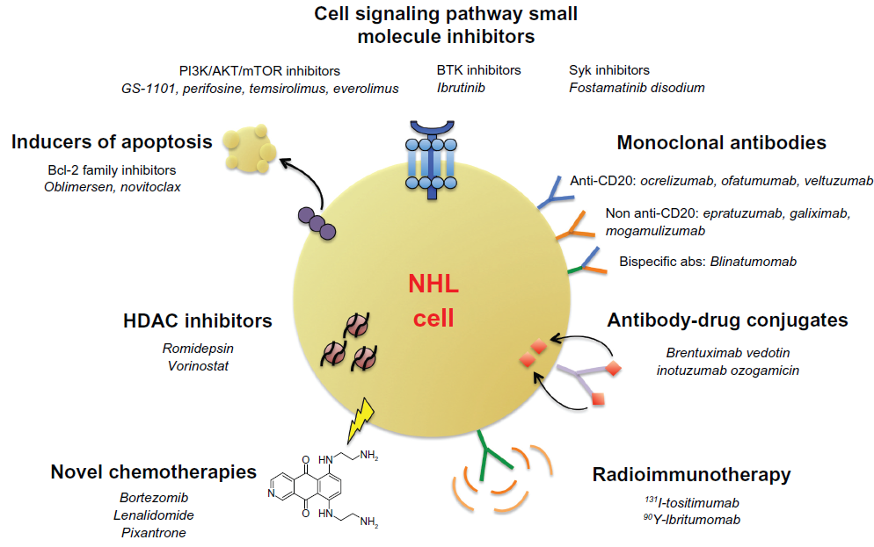
M2-A
Future Lymphoma Treatments (2)
Emerging therapies for relapsed/refractory NHL:
Source: Chao MP. 2013.

Slide 54
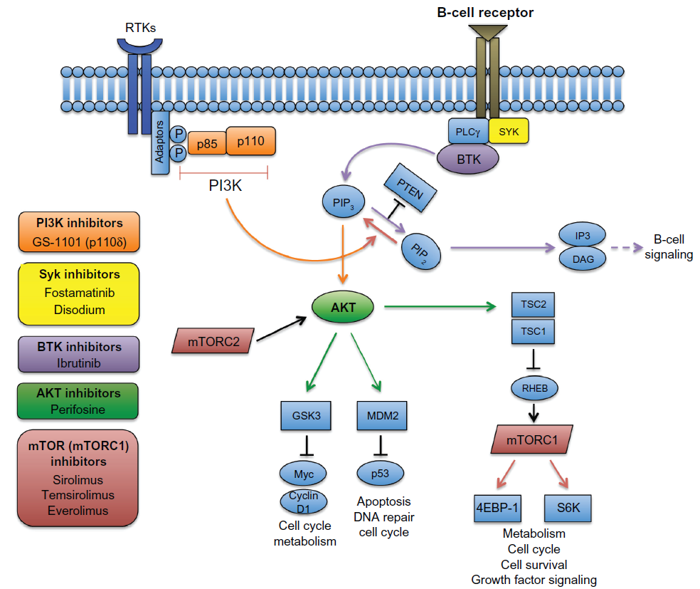
M2-A
Future Lymphoma Treatments (3)
Targeting the PI3K and BTK pathways in NHL:
Source: Chao MP, 2013.

Slide 55
Module 2B:
Nursing Implications:
Key role of nurses in managing lymphoma patients

Slide 56

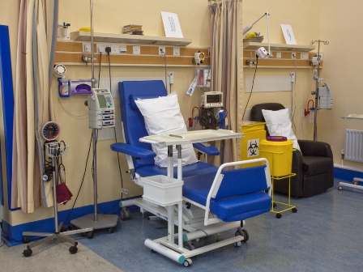

M2-B
Nursing Care of Lymphoma Patients
Assessments and follow-up
Treatment administration and management of side effects
Providing information, advice and emotional support
Source: Liptrott S. IEO 2009; www.mskcc.org

Slide 57
M2-B
Patient Support During “Watch-and-wait”
Providing:
  Information and advice
    Expectations, follow-up
  Emotional support and reassurance
  Instructions for personal care
Managing uncertainty
Source: Elphee EE, 2008.

Slide 58

M2-B
Patient Support During Chemotherapy
Provide information about the treatment plan
  Treatment schedule and duration
  Venous access device (if applicable)
  Anticipated side effects
    e.g. infections, explaining the symptoms and how to avoid them, particularly if blood cell counts are low
  Contacting the medical team if necessary
Address fertility issues and provide support
Management of side-effects
Source: Nagel T, 2004.

Slide 59
M2-B
Patient Support During Immunotherapy
Counselling patients on treatment administrations and anticipated outcomes and side-effects
  Dosing schedule
  Important safety information [see Module 3A]
  Important administration precautions
Premedication (prophylactic antipyretic and antihistamine)
Source: Long JM, 2007.

Slide 60
M2-B
Patient Support During Immunotherapy
Monitoring of vital signs (heart rate, blood pressure, respiratory rate) during and after the first infusion
Providing supportive care, as required
  e.g. reassuring the patient about chills and shaking, until symptoms resolve
Source: Long JM, 2007.

Slide 61
M2-B
Patient Support During Radiotherapy
Provide information about the treatment and its side-effects
Support and care before treatment:
  address patient concerns
  give instructions on skin care to minimise complications and discomfort
  address fertility issues
  assess for infection, skin integrity, dehydration, and sufficient haemoglobin level
  Premedication
Management of side effects
Source: Quinn LK, 2010; Poirier P, 2013.

Slide 62
M2-B
Patient Support Pre- and Post-transplant
Counselling patients on the procedure and anticipated outcomes and complications
Premedication before SCT, to reduce unwarranted symptoms
Ensuring the patient is hydrated before, during and after stem cell infusion
Providing follow-up care to help prevent and treat complications
Source: Brown M, 2010.

Slide 63
M2-B
Patient Support Pre- and Post-transplant
Discharge plan and home care taking into consideration the type of transplant and the risk of complications
Ensuring consistent communication between outpatient and home caregivers
Note: Unit-specific recommendations should be followed.
Source: Brown M, 2010.

Slide 64

M2-B
Supportive and Palliative Care
Supportive Care
Aims to alleviate the symptoms and complications of cancer, and to reduce or prevent the toxicities of cancer treatment.
Includes:
  Providing advice and information regarding care options, practical, and social needs
  Providing help with emotional and physical needs
  Assisting in symptom relief
  Providing contacts for care and support
    Support groups
Source: www.who.int/cancer/palliative

Slide 65

M2-B
Supportive and Palliative Care
Palliative Care
  Provides relief from pain and other distressing symptoms
  Enhances quality of life
  May also positively influence the course of illness
  Integrates the psychological and spiritual aspects of patient care
  Offers a support system to:
    Help patients live as actively as possible until death and
    Help the family cope during the patients illness
  Regards dying as a normal process and intends neither to hasten or postpone death; however, it offers a support system to help the family cope in their bereavement
Source: www.who.int/cancer/palliative

Slide 66

M2-B
Nursing Care

Slide 67
Module 2
References (1)
Balducci & Carreca, Crit Rev Oncol Hematol. 2003 Oct 15;48(Suppl):S65-70.
Barton S et al., Oncologist. 2012;17(12):1562-73.
Brown M. Nurs Stand. 2010 Nov 17-23;25(11):47-56; quiz 58.
Chao MP. Cancer Manag Res. 2013 Aug 23;5:251-69.
Dreyling M et al. [ESMO Guidelines – FL]. Ann Oncol. 2011 Sep;22 Suppl 6:vi59-63.
Dreyling M et al. [ESMO Guidelines – MZL, MCL, PTCL]. Ann Oncol 2013; 24: 857–877.
Eichenauer DA et al. [ESMO Guidelines - HL]. Ann Oncol. 2011 Sep;22 Suppl 6:vi55-8.
Eichhorst B et al. [ESMO Guidelines – CLL]. Ann Oncol. 2011 Sep;22 Suppl 6:vi50-4.
Elphee EE. Oncol Nurs Forum. 2008 May;35(3):449-54.
European Society for Medical Oncology. Ann Oncol 2005; 16 (Suppl 1).
Gisselbrecht C. Hematology Am Soc Hematol Educ Program. 2012;2012:410-6.
Hudson & Donaldson, Ped Clin N America 1997;44(4):894-895.
Kosits C and Callaghan M. Oncol Nurs Forum 2000; 27: 51–9.
Lerner R and Burns L. Bone Marrow Transplantation 2003; 31: 531–7.
Lionberger JM and Armitage JO. Expert Rev Anticancer Ther 2001; 1: 43–52.
Long JM. Clin J Oncol Nurs. 2007 Feb;11(1 Suppl):13-21.
Nagel T. RN. 2004 Oct;67(10):25-6, 28-30; quiz 31.
Otto SE. Oncology Nursing. Third edition. St Louis: Mosby, 2000.

Slide 68
Module 2
References (2)
Pereg D et al. Haematologica. 2007 Sep;92(9):1230-7.
Place AE et al. Br J Haematol. 2013 Sep 6. doi: 10.1111/bjh.12556.
Poirier P. Nursing: Research and Reviews. 2013(3):47-57.
Provan D et al. Oxford handbook of clinical haematology. Oxford University Press, 2004.
Quinn LK. Oncology Nurse Advisor May 2010:35-36.
Ramphal et al., Cancer. 2011 May 15;117(10):2316-22.
Repetto, J Support Oncol. 2003 Nov-Dec;1(4 Suppl 2):18-24.
Saouhami R & Tobias J. Cancer and its management. Blackwell Science, Oxford, 2003.
Sehn L et al. Blood 2004; 104: 394a.
Shankland KR et al. Lancet. 2012 Sep 1;380(9844):848-57.
Stein RS and Greer JP. In: Skeel RT. Ed. Handbook of Cancer Chemotherapy. Lippincott Williams and Wilkins, 2003: 503–24.
Tilly H et al. [ESMO Guidelines - DLBCL]. Ann Oncol. 2012 Oct;23 Suppl 7:vii78-82.
Ujjani C, Cheson BD. Expert Rev Hematol. 2013 Apr;6(2):191-202; quiz 203.
World Health Organization. WHO Definition of Palliative Care
Wood WA and Lee SJ. Blood. 2011 Jun 2;117(22):5803-15.
Younes A. Nat Rev Clin Oncol. 2011 February;8(2):85–96.
Zucca E et al. [ESMO Guidelines - Gastric MZL MALT]. Ann Oncol. 2013 Oct;24 Suppl 6:vi144-8.

Slide 69
M2
Questions & Answers
  Questions from Training Participants?

