Slide 1
Lymphoma Learning Programme
for Nurses and
Allied Healthcare Professionals
September/2014

Slide 2
Module 1:
Overview of the Basic Science

Slide 3
Module 1 Objectives
After completing this module, participants should be able to describe:
  What a lymphoma is
  Who is affected by a lymphoma and how frequent it is
  How a lymphoma develops and which cells and tissues are involved in the disease process
  The signs, symptoms and stages of a lymphoma
  The techniques used to diagnose and investigate lymphomas, and the prognostic indices used for lymphoma risk stratification

Slide 4
Module 1 Overview
Definition of lymphomas
Classification of lymphomas
Pathophysiology of lymphomas
Epidemiology, natural history, and prognosis for Non-Hodgkin lymphomas
Epidemiology, natural history, and prognosis for Hodgkin lymphoma
Diagnosis and Staging

Slide 5
Module 1A:
Definition of Lymphoma

Slide 6
M1-A
Definition of Lymphoma
Overview of the lymphatic system, haematopoiesis, and lymphocyte development
What is a lymphoma?
Cells and organs involved in lymphoma development
Molecular biology of a lymphoma & therapeutic targets

Slide 7
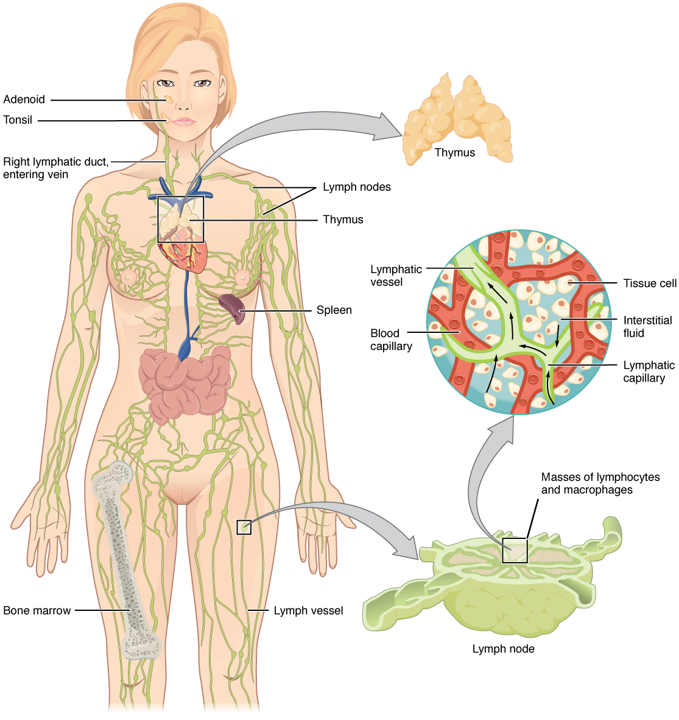
M1-A
The Lymphatic System
Major components:
Lymphatic vessels
Lymph nodes
Lymphatic organs
  Tonsils
  Thymus
  Spleen
  Peyer’s patch
Lymph fluid
Bone marrow
Source: Rice University/OpenStax College, Anatomy and Physiology – Chapter 21: The Lymphatic and Immune System

Slide 8
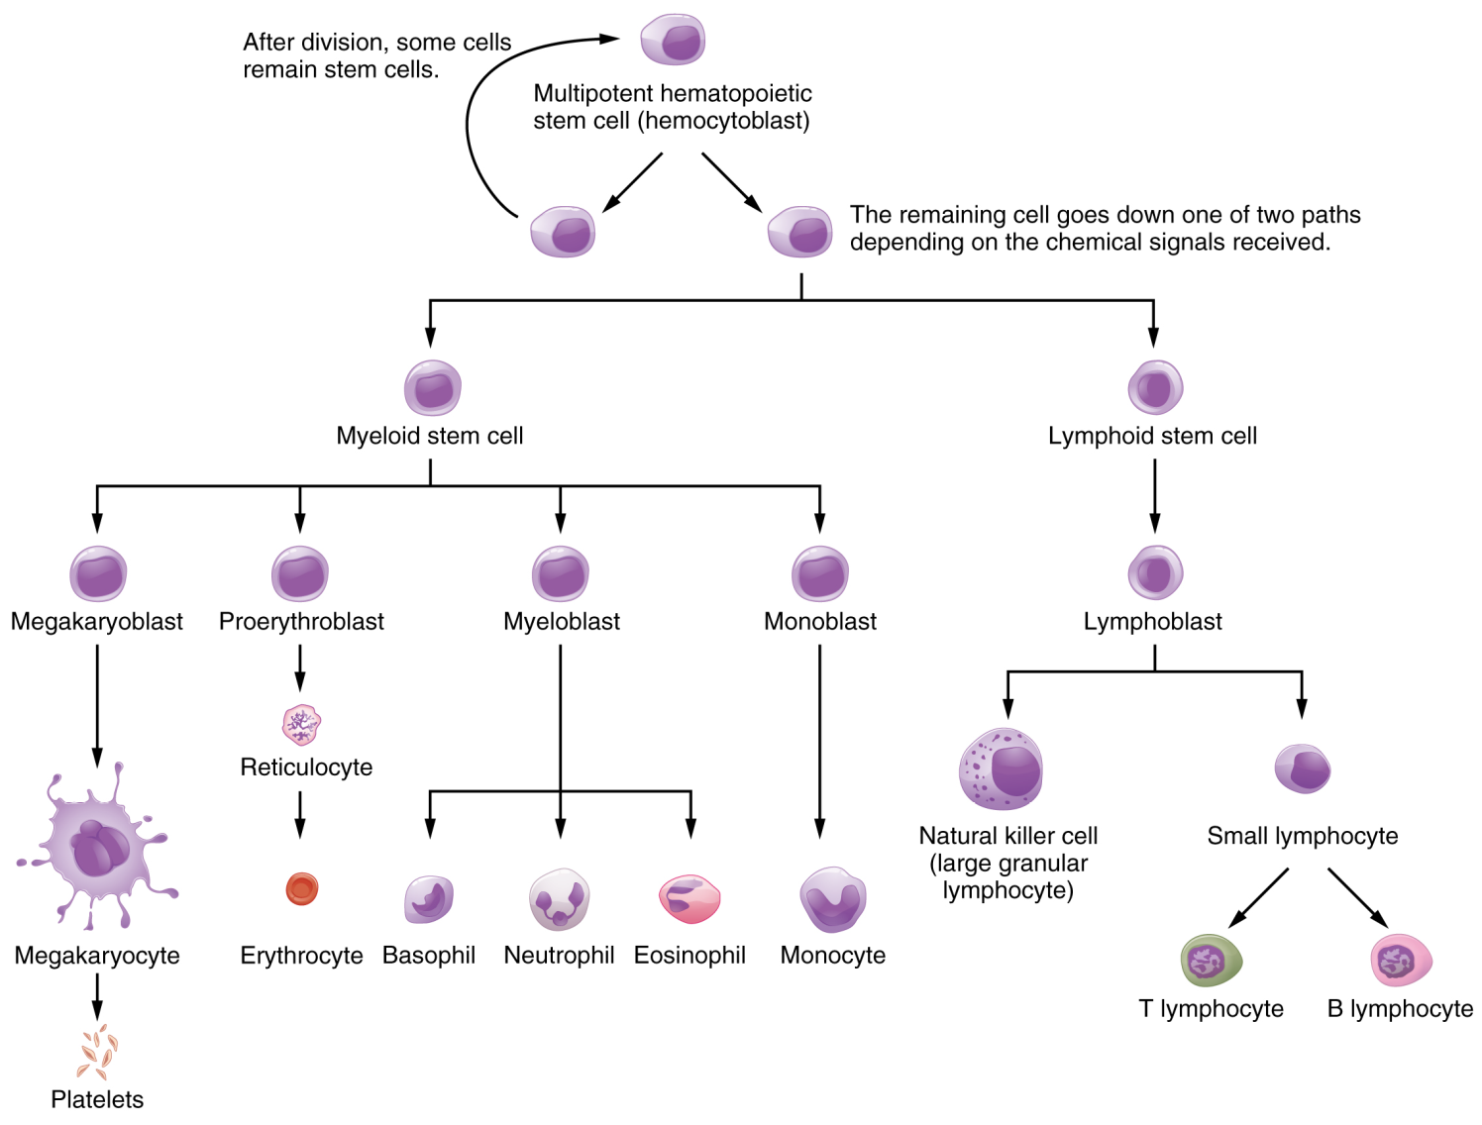
M1-A
Haematopoiesis
Development of blood cells from pluripotent hematopoietic stem cells
Source: Rice University/OpenStax College, Anatomy and Physiology – Chapter 21: The Lymphatic and Immune System

Slide 9
M1-A
Lymphopoiesis (1)
Lymphocytes develop and mature from stem cells into B or T cells
The initial generation of B and T lymphocytes occurs in the primary lymphoid tissues:
  Bone marrow (B lymphocytes) and
  Thymus (T lymphocytes)
Secondary lymphoid tissues (e.g. lymph nodes, spleen, tonsils, and the lymphoid tissue located in the gastrointestinal and respiratory tracts) are also involved in the development and differentiation of lymphocytes

Slide 10
M1-A
Lymphopoiesis (2)
Lymphocyte development is a complex process, highly controlled by many different genes which act at specific stages of B or T cell differentiation
Characteristic combinations of CD (cluster of differentiation) antigens are present on different lymphocyte types and stages
Various forms of lymphomas are derived from different lymphocyte types and stages
  Can be identified and distinguished by CD antigen expression
  Most B cell lymphomas express the CD19 and CD20 antigen
  CD30 is the hallmark for several Peripheral T Cell Lymphoma types (e.g. ALCL), and classical Hodgkin Lymphoma

Slide 11
M1-A
What is a Lymphoma?
Cancer of the lymphatic system
Most common blood cancer
Occurs when lymphocytes (B or T cells) grow and multiply uncontrollably
Cancerous lymphocytes travel to the lymph nodes, spleen, bone marrow, blood, or other organs, and form a tumor
Two main forms:
  Hodgkin lymphoma (HL) and
  Non-Hodgkin lymphoma (NHL)

Slide 12
Module 1B:
Classification of Lymphoma

Slide 13
M1-B
Classification of Lymphomas
Historical (Outdated) classifications
  Rappaport classification (1966)
  Rye classification for Hodgkin disease (1966)
  Lukes and Collins’ classification (1974)
  Kiel classification for B and T cell lymphomas
  NCI Working Formulation for Non-Hodgkin Lymphoma (NHL) (1982)
  The Revised European American Lymphoma (REAL) Classification (1993)
Source: Müller et al., 2005; Lu, 2005

Slide 14
M1-B
Classification of Lymphomas
Current Classification:
  WHO Lymphoma Classification, 4th edition (2008)
    Tumors of hematopoietic and lymphoid tissues:
      Mature B cell neoplasms
      Mature T cell and NK-cell neoplasms
      Hodgkin Lymphoma
      Histiocytic and dendritic cell neoplasms
      Post-transplantation lymphoproliferative disorders (PTLDs)
Source: Swerdlow SH et al., 2008

Slide 15
M1-B
WHO Classification, 2008
Lymphomas
  Non-Hodgkin Lymphomas (NHL)
  Hodgkin Lymphomas (HL)
  Precursor lymphoid neoplasms
  Nodular Lymphocyte predominant HL
  B-LB NOS
  T-LB
  B-LB NOS with genetic abnorm.
  Classical HL
  Mature B-cell neoplasms
  Nodular Sclerosis CHL
  Mature T-cell and NK-cell neoplasms
  Lymphocyte-rich CHL
  Histiocytic and dendritic cell neoplasms
  Mixed cellularity CHL
  Posttransplantation lymphoproliferative disorders (PTLDs)
  Lymphocyte-depleted CHL
Source: Swerdlow SH et al., 2008

Slide 16
M1-B
Classification of NHL (1)
Non-Hodgkin’s lymphoma (NHL)
  Old classification
    Aggressive / High-grade (B-cell, T-cell)
    Indolent lymphomas / Low-grade (B-cell, T-cell)
  WHO Lymphoma Classification, 4th edition
    Precursor lymphomas
    Mature B-cell lymphomas
    Mature T-cell and NK-cell lymphomas
Source: Swerdlow SH et al., 2008

Slide 17
M1-B
Classification of NHL (2)
“Indolent” Lymphoma
B-cell Type (~85-90%)
B-CLL/SLL (Lymphocytic Lymphoma)
B-PLL (Prolymphocytic Leukemia)
Hairy-cell Leukemia
Splenic Marginal-zone Lymphoma (MZL)
Nodal MZL
Extra-nodal MZL (MALT-Lymphoma)
Mantle Cell Lymphoma (MCL)
Follicular Lymphoma (FL, Grade I-II)
Primary Cutaneous Follicle Center Lymphoma
T-cell Type (~10-15%)
T-PLL (Prolymphocytic Leukemia)
T-cell large granular lymphocytic leukemia
Chronic NK-cell Proliferation
Mycosis fungoides (MF; cutaneous T-cell lymphoma)
Sézary Syndrome
Primary cutaneous CD30+ T-cell lymphoproliferative disorders
Source: Swerdlow SH et al., 2008; Bierman and Armitage, 2012

Slide 18
M1-B
Classification of NHL (3)
Aggressive Lymphoma
B-cell Type
Diffuse large B-cell lymphoma (DLBCL)
Primary cutaneous DLBCL
Primary mediastinal (thymic) large B-cell lymphoma
Intravascular large B-cell lymphoma
Burkitt Lymphoma
T-cell Type
Anaplastic large cell lymphoma (ALCL)
Peripheral T-cell lymphoma, NOS
Extranodal NK/T-cell lymphoma, nasal
Enteropathy-associated T-cell lymphoma
Hepatosplenic T-cell lymphoma
Source: Swerdlow SH et al., 2008; Bierman and Armitage, 2012

Slide 19
M1-B
Distribution of Lymphoma Types
Common B-cell Lymphoma Types
Source: DeVos 2006

Slide 20
Module 1C:
Pathophysiology of Lymphoma

Slide 21
M1-C
Pathophysiology of Lymphoma
Causes: unknown
Risk factors:
  Primary immune deficiency
    e.g. SCID syndrome, Wiskott–Aldrich syndrome, Ataxia–telangiectasia [Louis−Bar syndrome]
  Acquired immune deficiency
    Viral infection (HIV, HTLV, EBV, HCV)
    Post-organ transplant
  Family history of NHL (no hereditary pattern established)
  Autoimmune disease
  Long-term exposure to chemicals (pesticides, fertil­izers or organic solvents)

Slide 22
Module 1D:
Epidemiology, Natural History & Prognosis for NHL

Slide 23
M1-D1
Epidemiology of NHL (1)
NHL Incidence
  NHL is the tenth most common cancer worldwide
  With an estimated 356,000 new cases diagnosed in 2008 (3% of the total), it comprises 41% haematological cancers worldwide
  Incidence (age-standardized; per 100,000 per year):
    More developed countries: 10.3 (M) and 6.6 (F)
    Less developed countries: 4.3 (M) and 2.6 (F)
    US (SEER database): 17.1 (M) and 11.5 (F) for Caucasians and 12.6 (M) and 7.4 (F) for African Americans
    Annual rise of 1–4% observed between the 1970s and 1990s, resulting in almost a doubling of the NHL incidence, particularly in elderly people >55 years
Source: Müller et al., 2005; Cancer Research UK, Cancer Stats report – Non-Hodgkin Lymphoma (2014); SEER, 2013

Slide 24
M1-D1
Epidemiology of NHL (2)
Incidence of Common NHL Subtypes, UK 2004-2011
Source: Müller et al., 2005; Cancer Research UK, Cancer Stats report – Non-Hodgkin Lymphoma (April 2014)
http://www.cancerresearchuk.org/cancer-info/cancerstats/types/nhl/mortality/uk-nonhodgkin-lymphoma-mortality-statistics

Slide 25
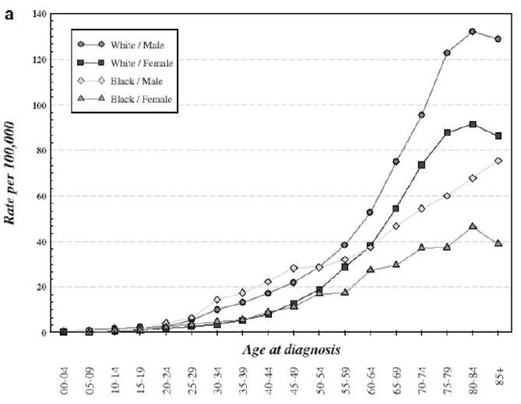
M1-D1
Epidemiology of NHL (3)
Figure a
Increasing NHL incidence (rate per 100,000) with age in gender and race subgroups according to SEER data.
Adopted from: Müller et al., 2005

Slide 26
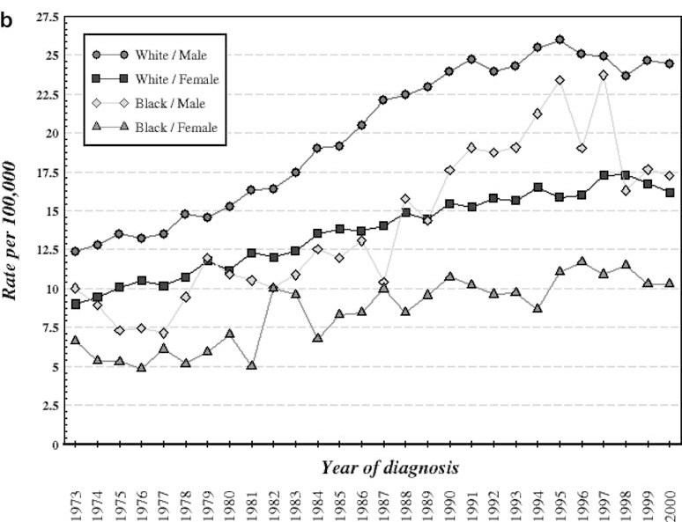
M1-D1
Epidemiology of NHL (4)
Figure b
NHL incidence increasing in various subgroups from 1973
through 2000 according to SEER data.
Adopted from: Müller et al., 2005

Slide 27
M1-D1
NHL-related Mortality (1)
Mortality rates from NHL in Europe per 100,000 population between 2005 and 2009
 | Non-Hodgkin Lymphoma
 | Men | Women
Overall age-adjusted mortality | 3.55 | 2.16
Average annual no. of deaths | 16,124 | 14,385
Source: Bosetti et al., Ann Oncol. 2013

Slide 28
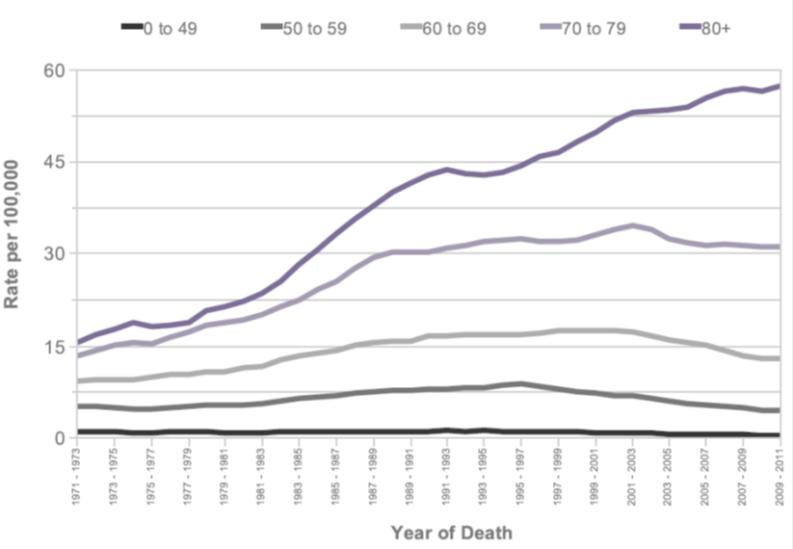
M1-D1
NHL-related Mortality (2)
European Age-standardized NHL-related mortality
Non-Hodgkin Lymphoma: European Age-Standardised Mortality Rates per 100,000 Population, by Age, Persons, UK, 1971-2011
Source: Cancer Research UK, Cancer Stats report – Non-Hodgkin Lymphoma (April 2014)
http://www.cancerresearchuk.org/cancer-info/cancerstats/types/nhl/mortality/uk-nonhodgkin-lymphoma-mortality-statistics

Slide 29
M1-D2
Natural History of NHL
Natural history of NHLs:
  Depends on the lymphoma type. Examples:
    DLBCL: onset in adulthood (sometimes in children; aggressive (fast-growing) lymphoma
    FL: typical onset in middle-aged and older adults; the most common indolent (slow-growing) form of NHL, but ~30-40% eventually transform into a more aggressive lymphoma
    MZL: median age for diagnosis is 65 years; indolent (slow-growing) B-cell lymphoma
    CLL/SLL: indolent (slow-growing), however, it can progress to a more aggressive type of lymphoma over time
    PTCL: affects adults; usually aggressive (fast-growing)

Slide 30
M1-D3
Prognosis in NHL (1)
Prognostic indices used for lymphoma International Prognostic Index (IPI)
    Developed in 1993, based on studies in 2031 patients with aggressive NHL from US, EU, and Canada
IPI Risk | No. of Risk Factors* | CR Rate | 5-YR RFS Rate in CR | 5-YR OS Rate
Low | 0 or 1 | 87% | 70% | 73%
Low intermediate | 2 | 67% | 50% | 51%
High intermediate | 3 | 55% | 49% | 43%
High | 4 or 5 | 44% | 40% | 26%
5 risk factors associated with survival: age (≤60 vs >60 years), tumor stage (stage I or II vs stage III or IV), the number of extranodal disease sites (≤1 vs >1), performance status (0 or 1 vs ≥2), and serum LDH level (≤1 times normal versus >1 times normal).
Source: The International NHL Prognostic Factors Project, NEJM 1993

Slide 31
M1-D3
Prognosis in NHL (2)
Prognostic indices for lymphoma (cont’d)
    Follicular Lymphoma International Prognostic Index (FLIPI, 2004)
      Low-, Intermediate- and High risk categories
      Includes risk factors: age, stage, Hb, the number of nodal site areas, and LDH
    Revised FLIPI (2009)
      Includes additional risk factors: 2-microglobulin >ULN, longest diameter of the largest involved node >6 cm, bone marrow involvement, Hb <12 g/dL, and age >60 years
Source: Solal-Celigny et al, Blood 2004; Federico et al. J Clin Oncol 2009

Slide 32
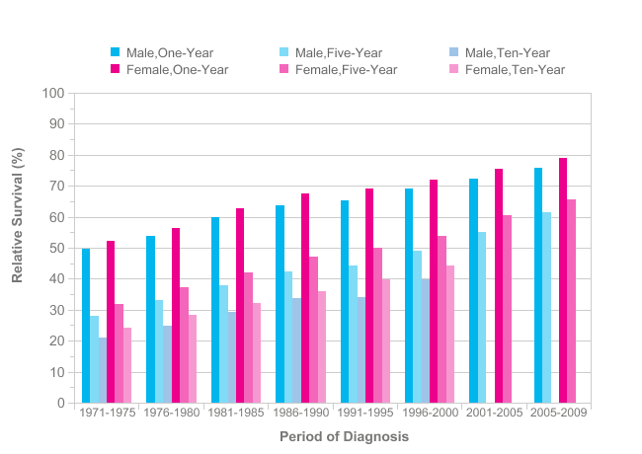
M1-D3
Prognosis in NHL (3)
NHL: 1-, 5- and 10-year survival by gender
Source: Cancer Research, UK, 1971-2009
http://www.cancerresearchuk.org/cancer-info/cancerstats/types/nhl/mortality/uk-nonhodgkin-lymphoma-mortality-statistics (April 2014)

Slide 33
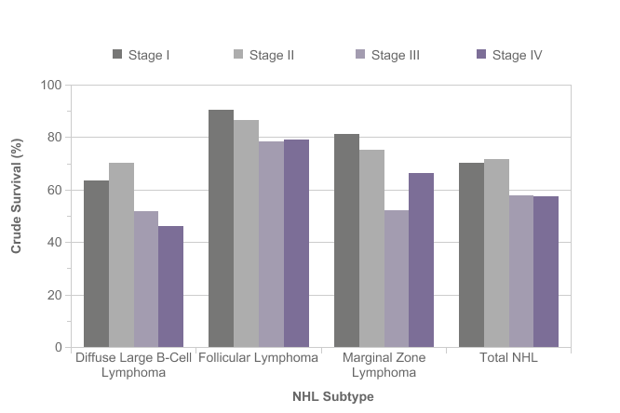
M1-D3
Prognosis in NHL (4)
NHL: 5-year survival by stage at diagnosis
Source: Cancer Research, UK, 1971-2009
http://www.cancerresearchuk.org/cancer-info/cancerstats/types/nhl/mortality/uk-nonhodgkin-lymphoma-mortality-statistics (April 2014)

Slide 34
Module 1E:
Epidemiology, Natural History & Prognosis for HL

Slide 35
M1-E1
Epidemiology of HL (1)
HL Incidence
  Uncommon malignancy
  Annual incidence is around 1.2 per 100,000 for males and 0.8 per 100,000 for females worldwide, and between 3 – 4 new cases per 100,000 persons in the Western world
  It accounts for less than 1% of all cancers worldwide and for 14% of lymphomas
  The highest rates are in Southern Europe and Northern America
  9,290 new cases and 1,180 deaths expected in US in 2013
  Bimodal peaks of incidence
    Peaks at 15-30 and > 50 years of age
Source: Cancer Research UK, Cancer Stats report –Hodgkin Lymphoma (2013); DeVos, 2006; Siegel R, et al. 2013; Lu, 2005; Rademaker, 2007; NCCN. Clinical practice guidelines in oncology: Hodgkin’s lymphoma. v.1.2013

Slide 36
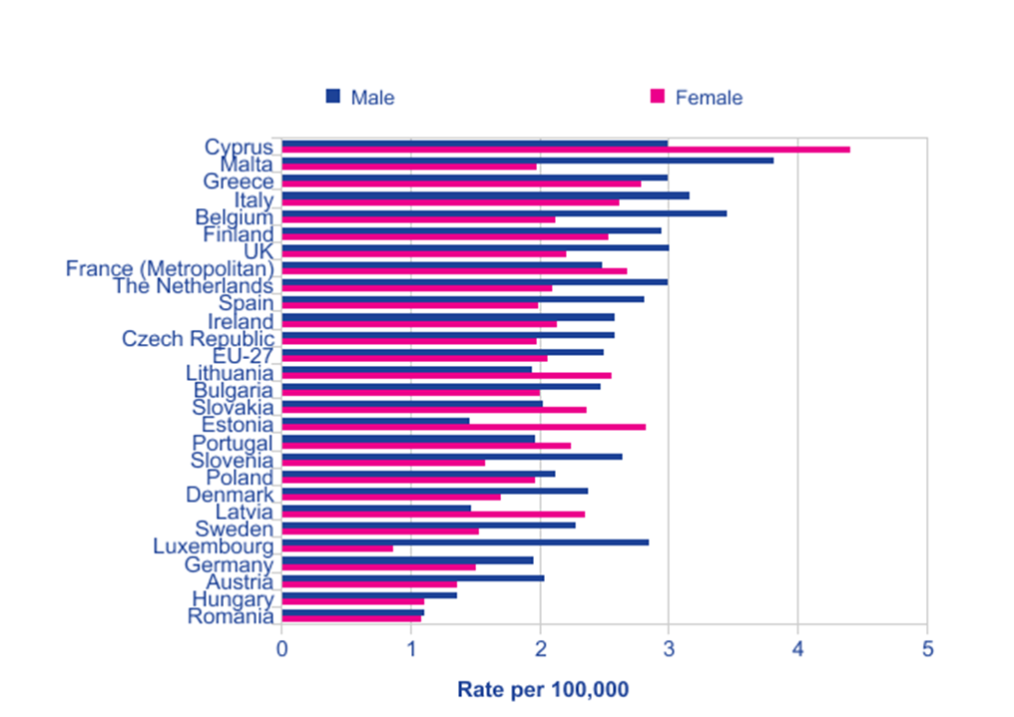
M1-E1
Epidemiology of HL (2)
European Age-Standardised Incidence, by EU-27 Country: HL
Hodgkin Lymphoma: European Age-Standardised Incidence Rates per 100,000 Population, by Gender, EU-27 Countries, 2008 Estimates
Source: Cancer Research UK, Cancer Stats report –Hodgkin Lymphoma (2013)
http://www.cancerresearchuk.org/cancer-info/cancerstats/types/nhl/mortality/uk-nonhodgkin-lymphoma-mortality-statistics (April 2014)

Slide 37
M1-E1
HL-related Mortality (1)
Mortality rates from HL in Europe per 100,000 population between 2005 and 2009
 | Hodgkin Lymphoma
 | Men | Women
Overall age-adjusted mortality | 0.42 | 0.26
Average annual no. of deaths | 1,576 | 1,237
Source: Bosetti et al., 2013

Slide 38
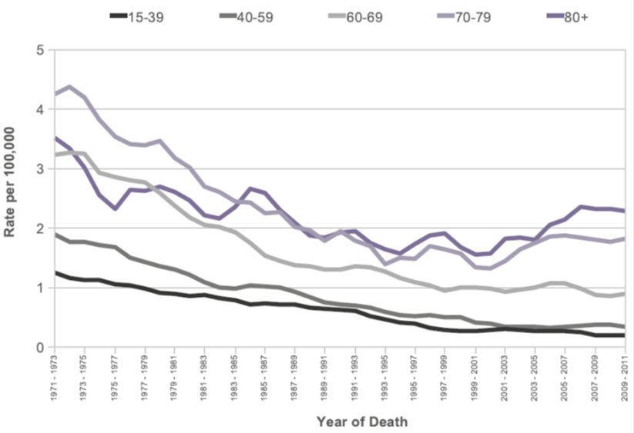
M1-E1
HL-related Mortality (2)
European Age-standardized HL-related mortality
Hodgkin Lymphoma: European Age-Standardised Mortality Rates per 100,000 Population, by Age, Persons, UK, 1971-2011
Source: Cancer Research UK, Cancer Stats report – Non-Hodgkin Lymphoma (2014) and Hodgkin Lymphoma (2013)
http://www.cancerresearchuk.org/cancer-info/cancerstats/types/nhl/mortality/uk-nonhodgkin-lymphoma-mortality-statistics (April 2014)

Slide 39
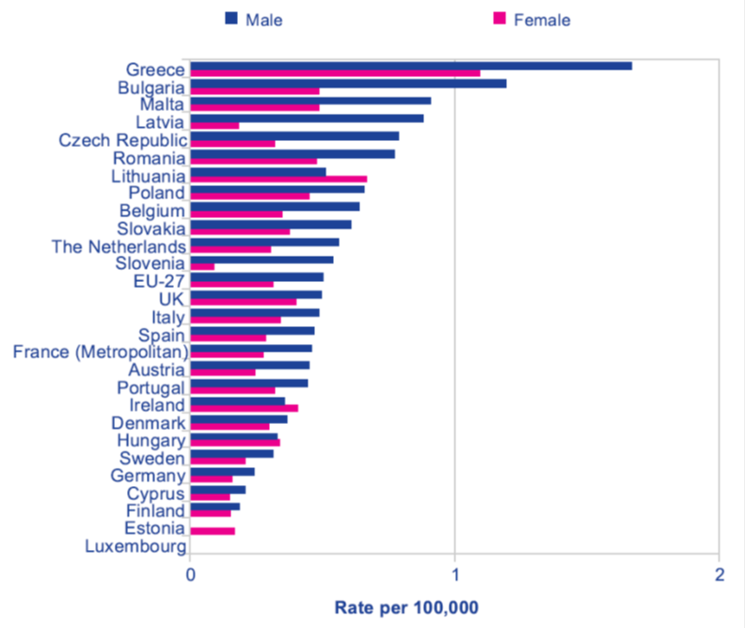
M1-E1
Lymphoma-related Mortality (3)
European Age-Standardised Mortality, by EU-27 Country: HL
Hodgkin Lymphoma: European Age-Standardised Mortality Rates per 100,000 Population, by Gender, EU-27 Countries, 2008 Estimates
Cancer Research UK, Cancer Stats report – Hodgkin Lymphoma (2013)
http://www.cancerresearchuk.org/cancer-info/cancerstats/types/nhl/mortality/uk-nonhodgkin-lymphoma-mortality-statistics (April 2014)

Slide 40
M1-E2
Natural History of HL
Natural history of HLs:
  Presenting clinical symptoms are variable and may create a diagnostic challenge
  The spread is usually predictable: lymph nodes → spleen→ liver → bone marrow and other extranodal sites
  Early and advanced disease are potentially curable with aggressive treatment
Source: NCCN. Clinical practice guidelines in oncology: Hodgkin’s lymphoma. v.1.2013

Slide 41
M1-E3
Prognosis in HL
Hodgkin Lymphoma: 5-year survival by stage at diagnosis
Source: SEER Cancer Statistics Review, 1975-2009 (Vintage 2009 Populations). 2012

Slide 42
Module 1F:
Lymphoma Diagnosis & Staging

Slide 43
M1-F
Lymphoma Diagnosis (1)
Initial assessment and diagnosis
  No screening tests or prevention methods available
  Usually not evident in the blood
  Detailed medical history
  Review of signs and symptoms of lymphoma
    General symptoms (e.g. fatigue, generalized itchiness, local pain)
    B symptoms (weight loss, fever, night sweating)

Slide 44
M1-F
Lymphoma Diagnosis (2)
Initial assessment and diagnosis (cont’d)
  Important questions to ask a patient:
    Have you noticed a lump in your neck, under your arms, in your groin, or elsewhere in your body?
    Have you been losing weight without trying?
    Have you been experiencing fevers?
    Are you sweating at night / when sleeping?
    Have you experienced any swelling in your legs (or other parts of your body), weakness in an arm or leg or back pain?
    Do you have a cough, any pain in your chest, or feel any unusual shortness of breath or difficulty breathing?
    Have you been experiencing headaches or vision problems?
    Have you felt stomach pain, bloating, feeling full?

Slide 45
M1-F
Lymphoma Diagnosis (3)
Initial assessment and diagnosis (cont’d)
  Complete physical exam
    Lymph node involvement (fixed vs. mobile, enlarged, palpable nodes, lymphadenopathy, visible swelling)
    Finding of a palpable mass anywhere in the body, and/or enlarged abdominal organs (hepatomegaly, splenomegaly, hepatosplenomegaly/HSM)
    Pharyngeal examination for tonsil or oropharynx involvement, Waldeyer’s ring involvement (NHL)
    Neurologic examination

Slide 46
M1-F
Lymphoma Diagnosis (4)
Initial assessment and diagnosis (cont’d)
  Diagnostic tests and techniques
    Lymph node biopsy (needle- or surgical biopsy)
    Blood tests (CBC, ESR, LDH, UA, LFTs, RFTs)
    Imaging (CXR, CT scan, MRI, US, PET scan)
    Biopsy & cytology (BM aspiration and/or biopsy, lumbar puncture [spinal tap], effusion)
    Molecular analysis
      Immunophenotyping
      Genotyping (Cytogenetic analysis, FISH, Southern blot hybridisation analysis, PCR)

Slide 47
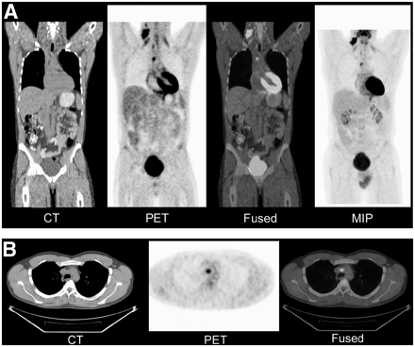
M1-F
Lymphoma Diagnosis (5)
PET-CT: Integrating FDG-PET and CT
PET/CT for staging of HL
A: coronal views
B: transverse views
MIP = maximum-intensity projection
CT shows involvement only in right neck. PET/CT shows that normal-size upper mediastinal lymph node was clearly metabolically active, changing stage from I to II.
Source: Kasamon et al., 2007

Slide 48
M1-F
Lymphoma Diagnosis (6)
2. Indications for biopsy
General:
  Age >40 years
  Lymph node >2 cm
  Supraclavicular location
  Firm, mobile, not tender
  Persists for several wks
  Abnormal CXR or CT
  Systemic symptoms
Urgent excisional biopsy:
  Spinal cord compression
  Airway obstruction
  Pericardial tamponade
  Obstruction of vena cava (superior/inferior)
  Suspected CNS mass
  Intestinal obstruction
  Ureteric obstruction
  Severe liver dysfunction

Slide 49
M1-F
Lymphoma Diagnosis (7)
3. Molecular diagnosis
Permits more precise definition of lymphomas
Important in predicting prognosis and response to treatment
Most common molecular analysis techniques
  Immunophenotyping
    Flow cytometry, immunohistochemistry
  Genotyping
    Cytogenetic analysis, fluorescence in situ hybridization (FISH), Southern blot hybridisation, and polymerase chain reaction (PCR)
DNA studies
  Detect oncogenes expressed in lymphoid malignancies and chromosomal translocations
    Examples: c-myc DNA amplification, bcl-2 oncogene analysis, beta-2 microglobulin (β2M)

Slide 50
M1-F
Lymphoma Staging (1)
Ann Arbor Staging for Lymphomas (NHL and HL)
Stage | Description of Involvement
I IE | Involvement of a single lymph node region Localized involvement of a single extralymphatic organ or site
II IIE | Involvement of ≥2 lymph node regions on the same side of the diaphragm Localized involvement of a single associated extralymphatic organ or site and its regional lymph nodes with or without other lymph node regions on the same side of the diaphragm
III IIIE IIIS IIIS+E | Involvement of lymph node regions on both sides of the diaphragm As above + localized involvement of an extralymphatic organ or site As above + involvement of the spleen. Both IIIS+IIIE
IV IVE | Disseminated (multifocal) involvement of 1 or more extralymphatic sites with or without associated lymph node involvement or isolated extralymphatic organ involvement with distant (non-regional) nodal involvement. Extranodal lymphoid malignancies arise in tissues separate from, but near, the major lymphatic aggregates.
Source: Carbone et al, 1971

Slide 51
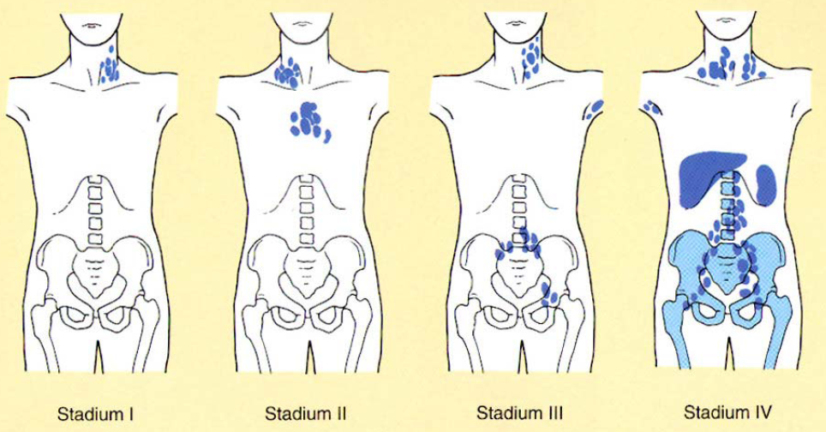
M1-F
Lymphoma Staging (2)
Lymphoma Stages according to Ann-Arbor Classification

Slide 52
M1-F
Lymphoma Staging (3)
Ann Arbor Staging for Lymphomas (Cont’d)
Sub-classifications:
  Without (A) or with (B) symptoms of fever, weight loss, night sweats
  Favorable or unfavorable (risk factors: low albumin, low hemoglobin, male, older age, leukocytosis, lymphocytosis, mediastinal mass)
Source: Edge SB, et al. 2010

Slide 53
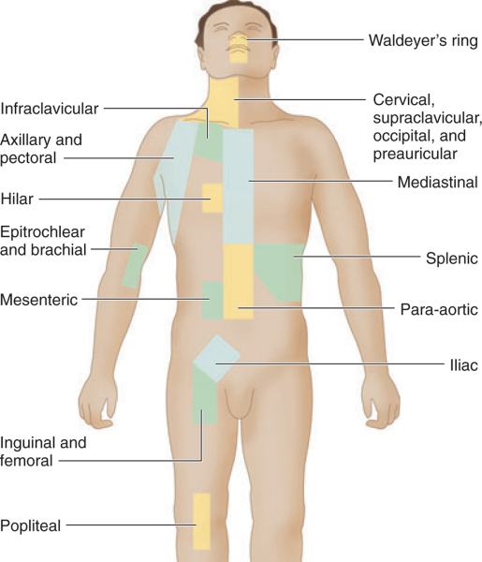
M1-F
Lymphoma Staging (4)
Anatomic definition of lymph node regions for staging of HL
Source: Kaplan and Rosenberg, 1966

Slide 54
M1
Summary of Module 1
What have we learned in Module 1?
  Lymphoma is the most common blood cancer.
  Lymphoma occurs when lymphocytes grow abnormally.
  The two main forms of lymphoma are HL (10-15% of all lymphomas) and NHL (85-90% of all lymphomas).
  The causes of NHL remain unknown, however, several risk factors are known that predict the clinical outcome.
  Lymphomas are divided into four stages based on how far the disease has spread.
  Long-term survival greatly depends on the type of lymphoma; however, it is generally longer in patients with Stage I-II vs Stage III-IV disease at the time of diagnosis.

Slide 55
M1
REFERENCES
Bierman PJ and Armitage JO. Non-Hodgkin’s Lymphomas. In: Goldman’s Cecil Medicine, 24th Edition, Philadelphia, PA; Saunders Elsevier; 2012: Chapter 191.
Bosetti et al. Ann Oncol. 2013 Oct;24(10):2657-71.
Cancer Research UK, Cancer Stats report – Hodgkin Lymphoma (2013)
Cancer Research UK, Cancer Stats report – Non-Hodgkin Lymphoma (2014)
DeVos S. PET Clinics 2006;1(3):203–17.
Edge SB et al. AJCC Cancer Staging Manual, 7th edition. 2010
Federico et al. J Clin Oncol. 2009 Sep 20;27(27):4555-62.
Kaplan and Rosenberg. Med Clin North Am. 1966;50:1591-1610.
Lu. Semin Nucl Med. 2005 Jul;35(3):160-4.
Mueller et al. Ann Hematol. 2005 Jan;84(1):1-12.
NCCN. Clinical practice guidelines in oncology: Hodgkin’s lymphoma. v.1.2013
Rice University/OpenStax College: Anatomy and Physiology – Anatomy of the Lymphatic and Immune System; Accessed at: http://cnx.org/content/m46563/1.3
Siegel R, et al. CA Cancer J Clin. 2013;63:11-30.
Solal-Celigny et al, Blood 2004 Sep 1;104(5):1258-65.
Swerdlow SH et al. WHO Classification of Tumors of Haematopoietic and Lymphoid Tissues, Fourth Edition. IARC Press: Lyon 2008

Slide 56
M1
Questions & Answers
  Questions from Training Participants?

